Slide 1
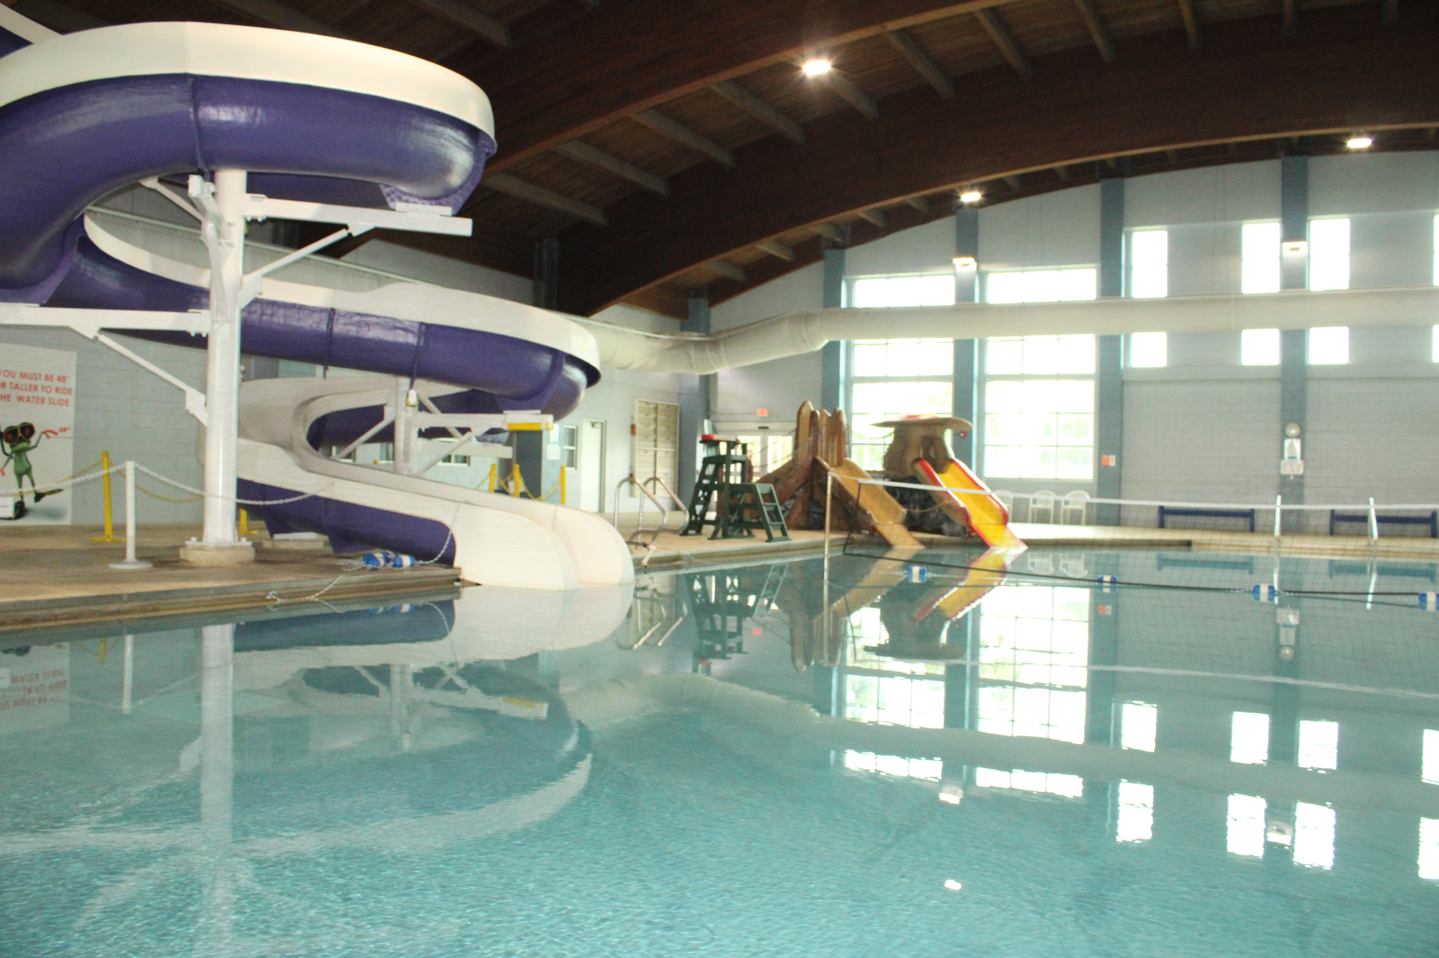

Natatorium Renovations

Slide 2
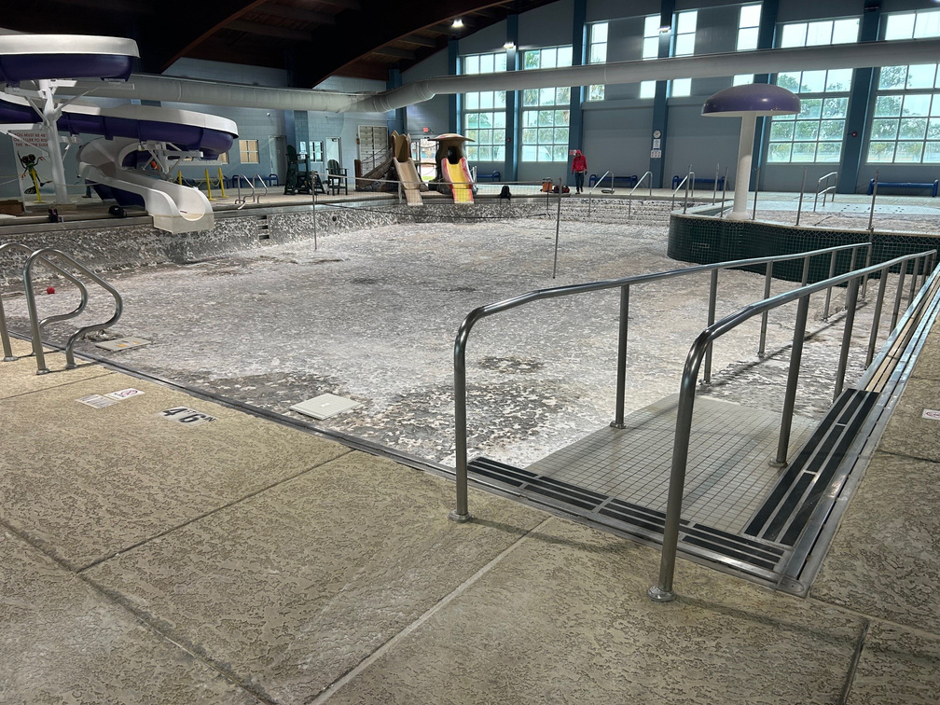
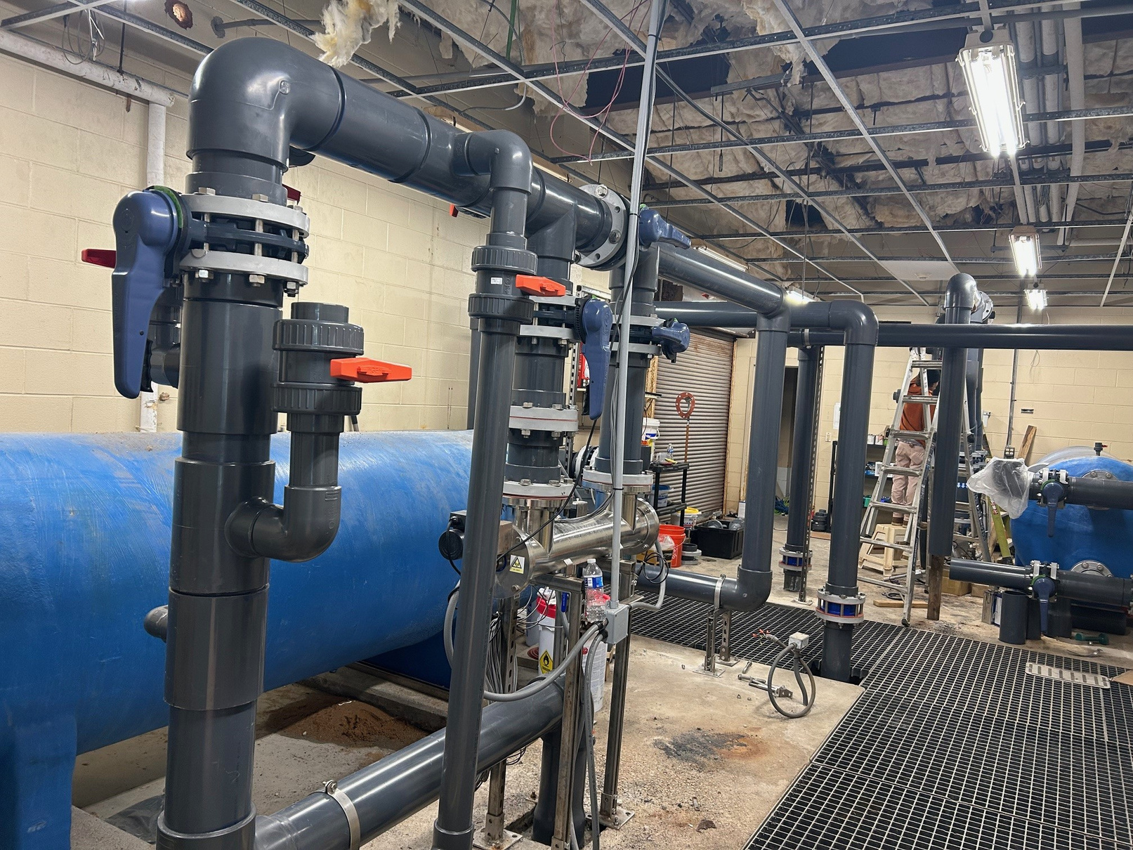
Projects Completed
Leisure Pool Re-plastering
PoolPak Replacement
Pump Room Re-piping

Slide 3
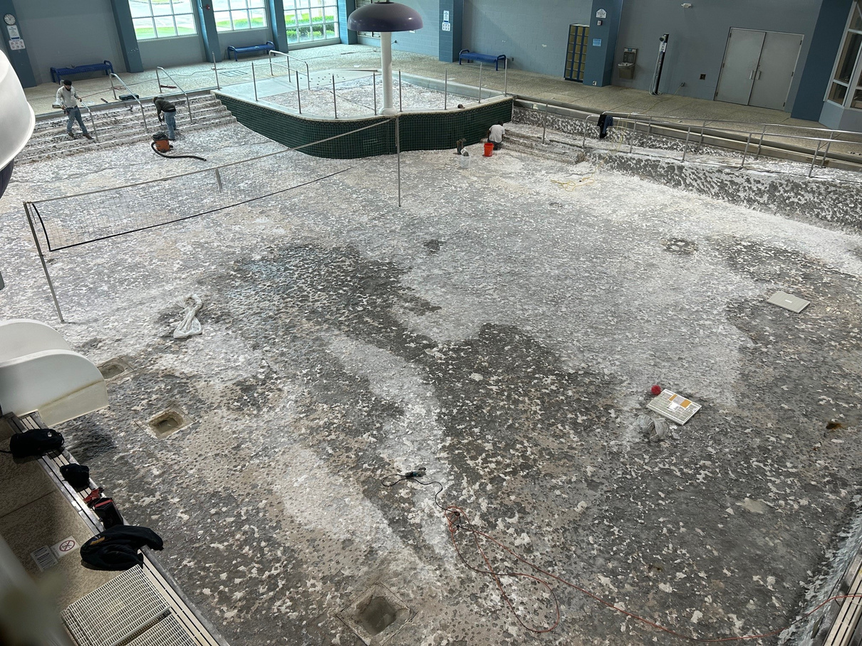
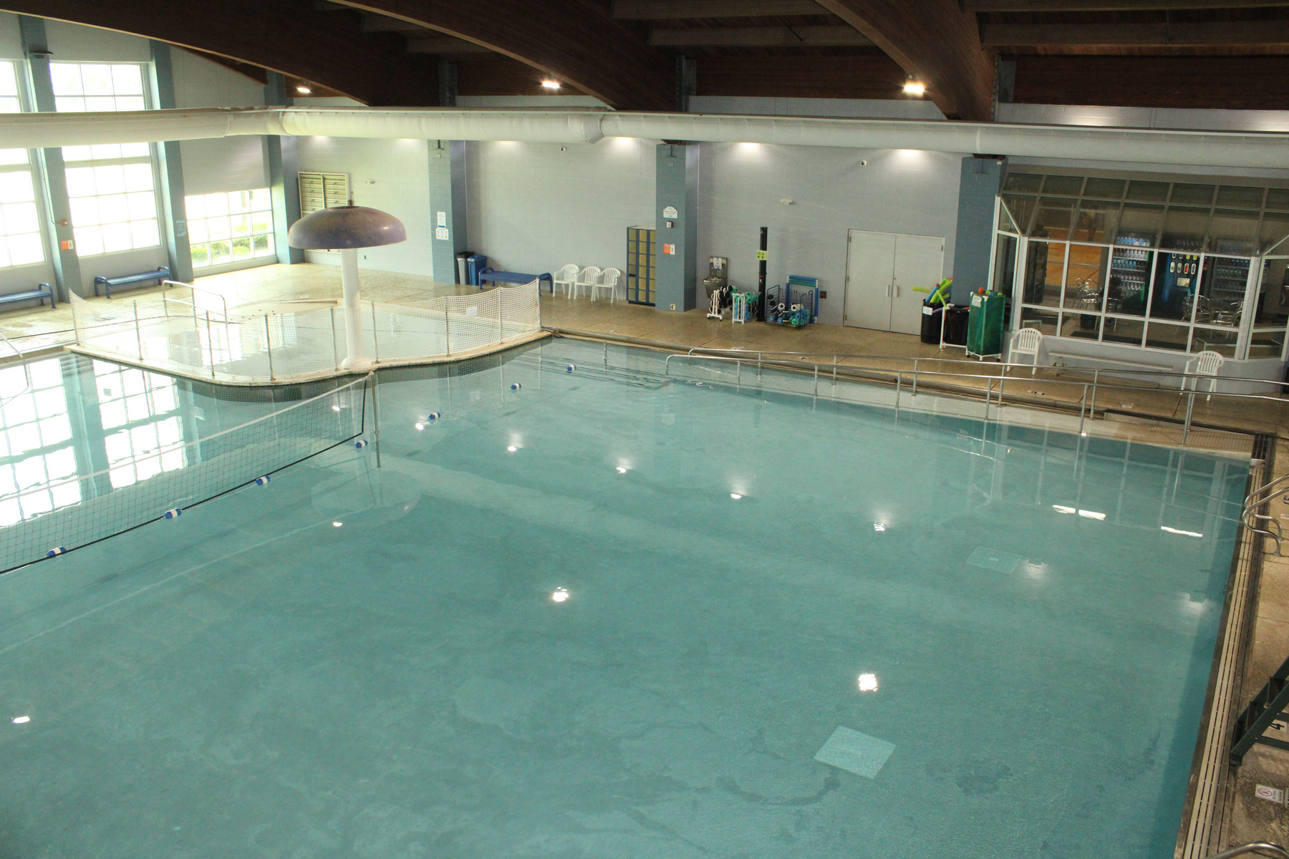
POOL RE-PLASTERING
BEFORE
AFTER

Slide 4
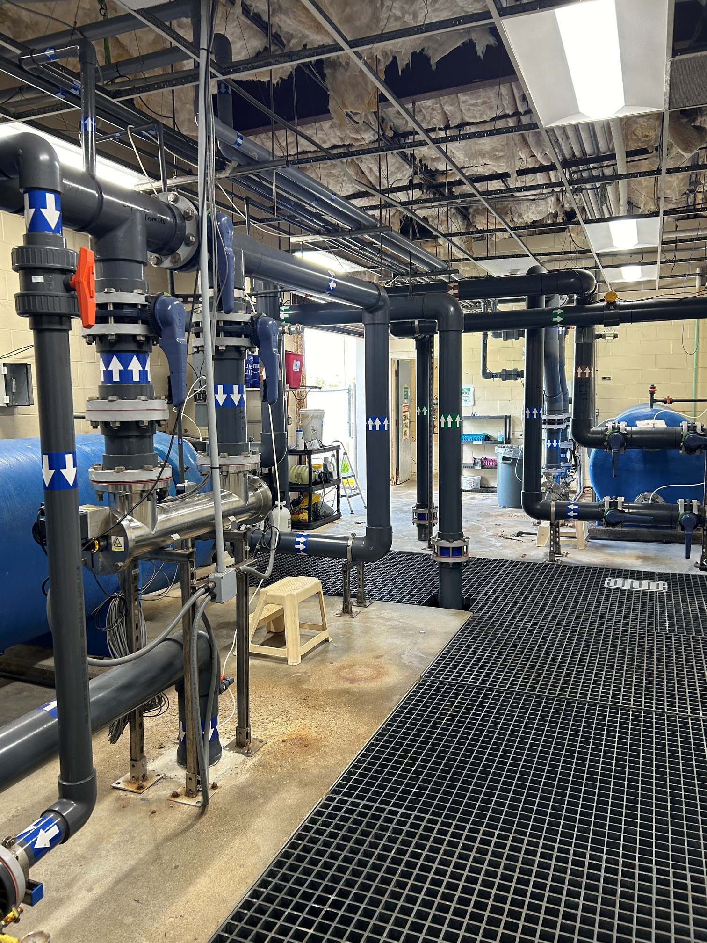
PUMP ROOM RE-PIPING
BEFORE
AFTER

Slide 5
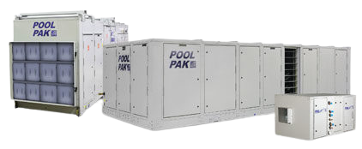
PoolPak
WHAT IS A POOLPAK?
WHAT IS THE LIFESPAN OF A POOLPAK?
A PoolPak is a dehumidification systems for large athletic pools, natatoriums in schools and universities, commercial pools and hotel/motel leisure pools.
PoolPak dehumidification equipment is built for the corrosive indoor pool environment with features like copper coil construction, key components located out of the corrosive air stream and a durable finish.
PoolPak’s helpmaintain maximum occupant comfort at the lowest first cost and ongoing operational cost.
PoolPak’s can typically last 20 years.

Slide 6

Where did the Funding come from?
All of these projects were funded through the Capital Improvement Program (CIP) which comes from the Half-Cent Sales Tax.

