Slide 1
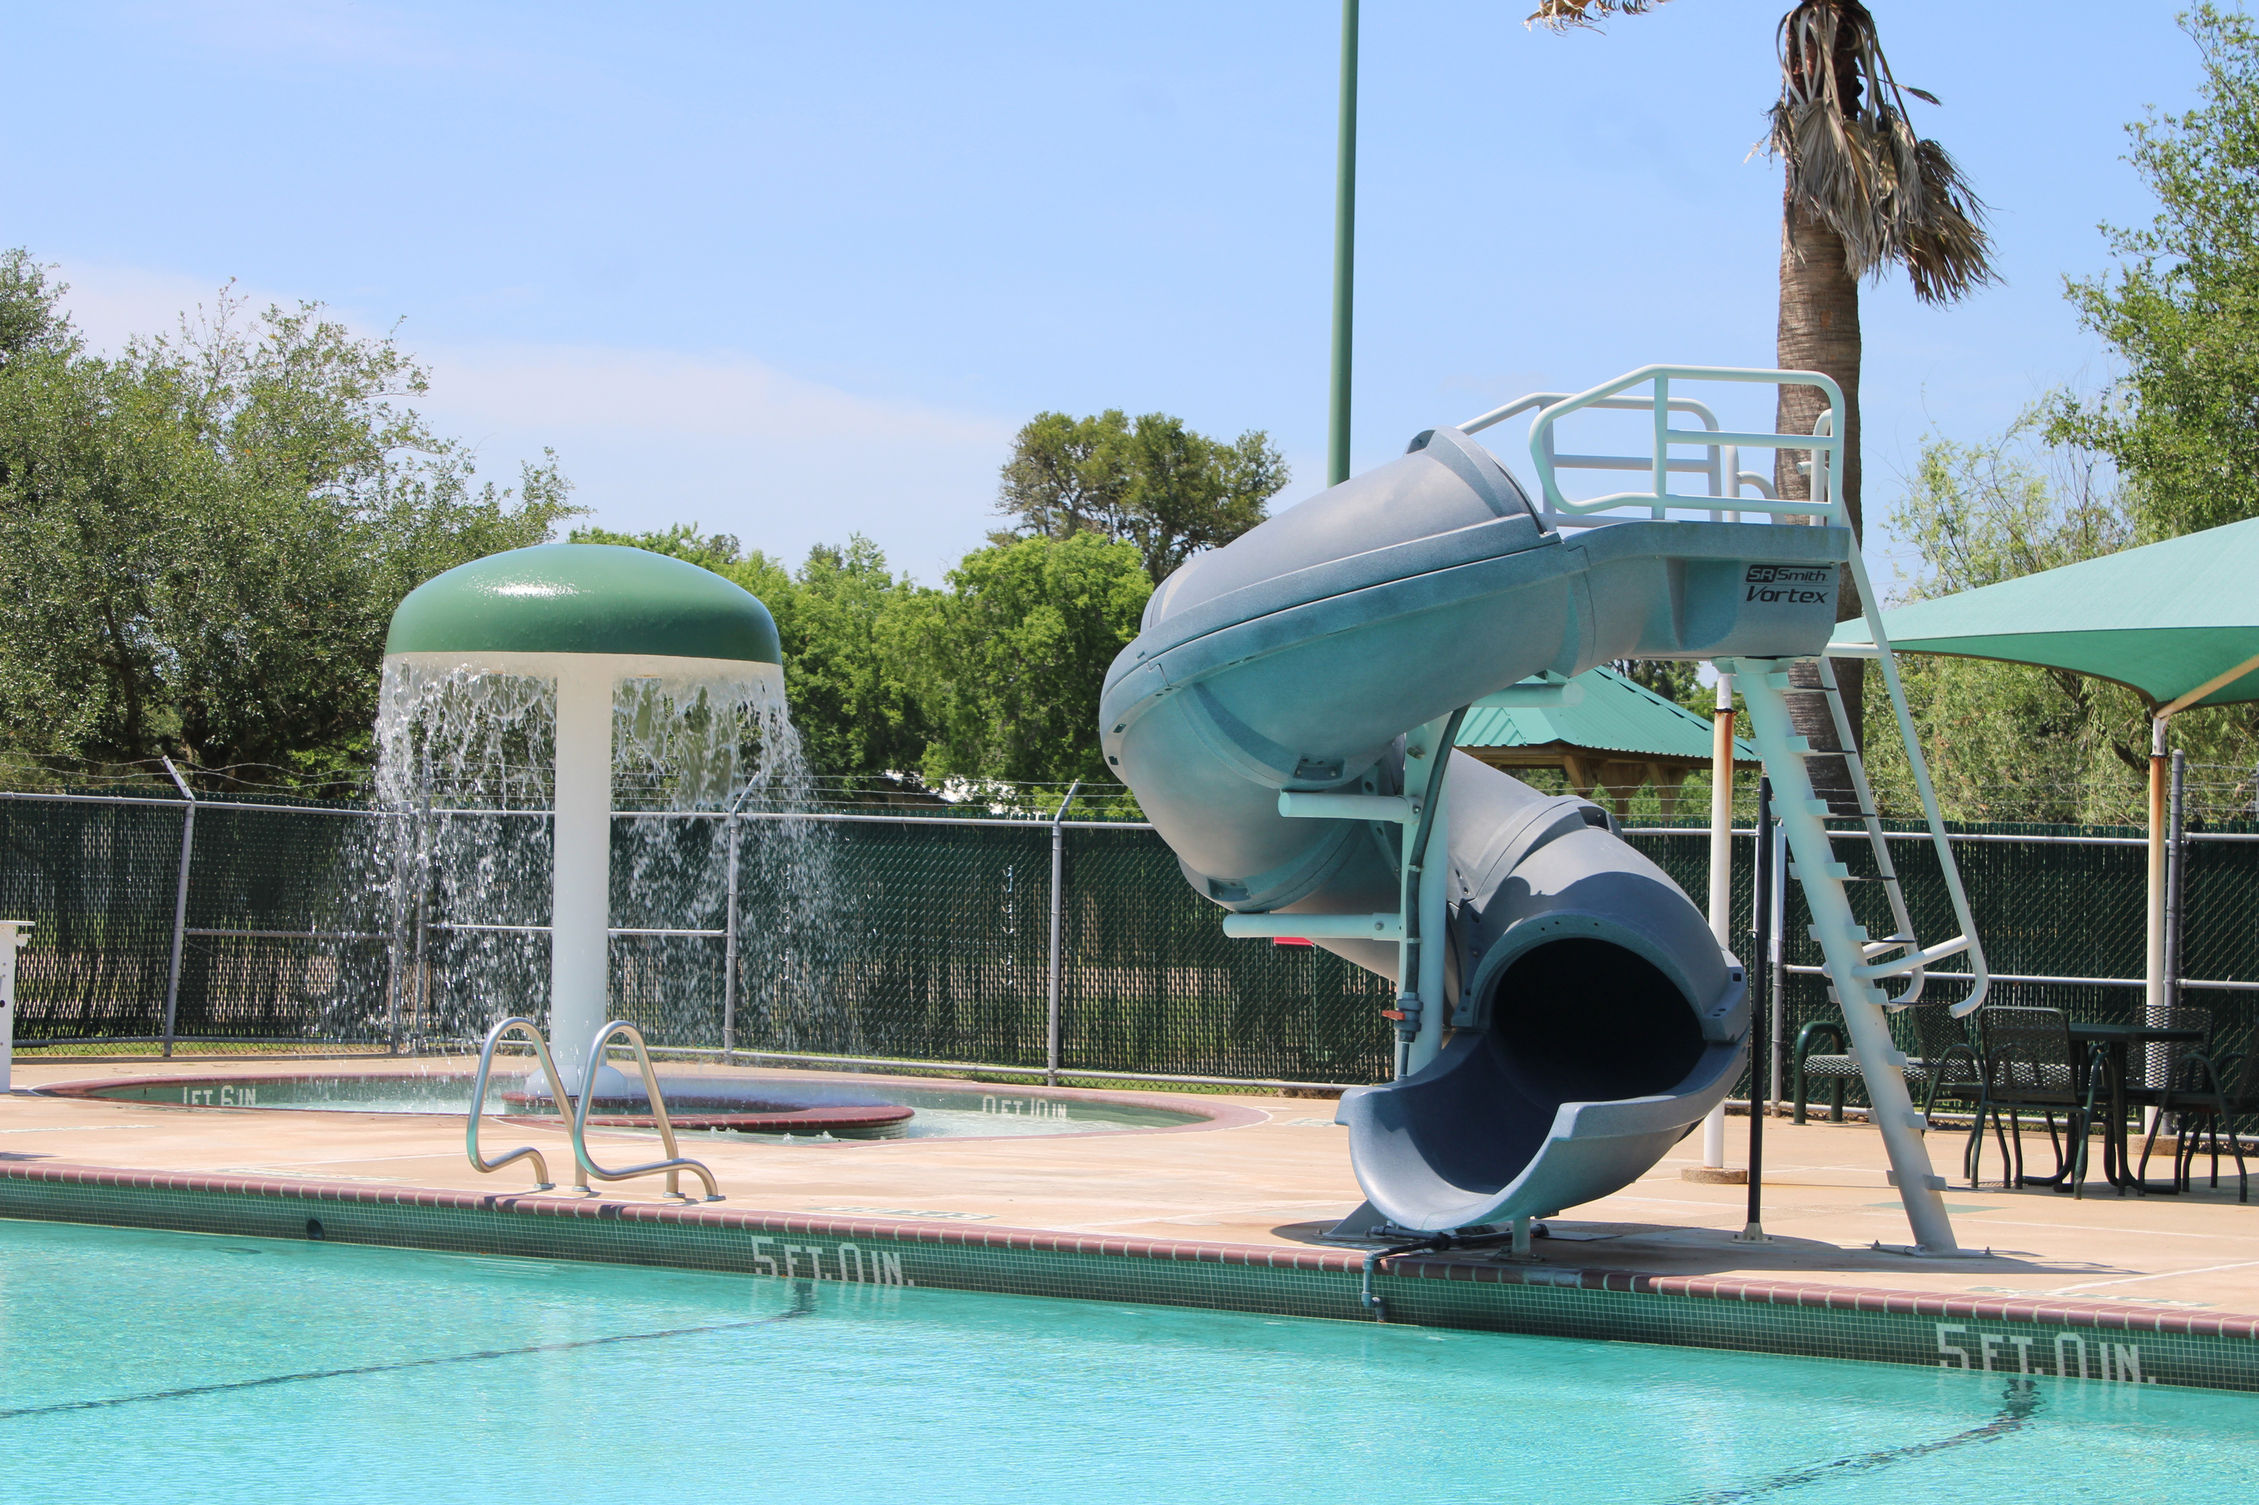

Madge Griffith Outdoor Pool Plaster

Slide 2
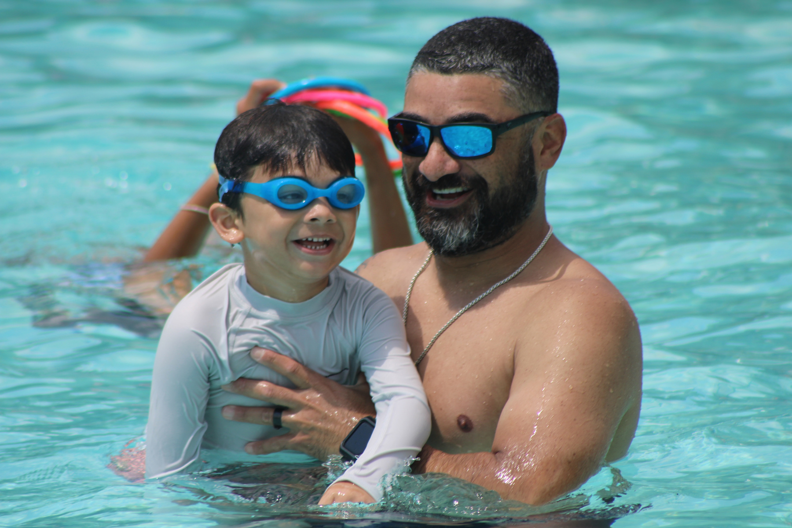
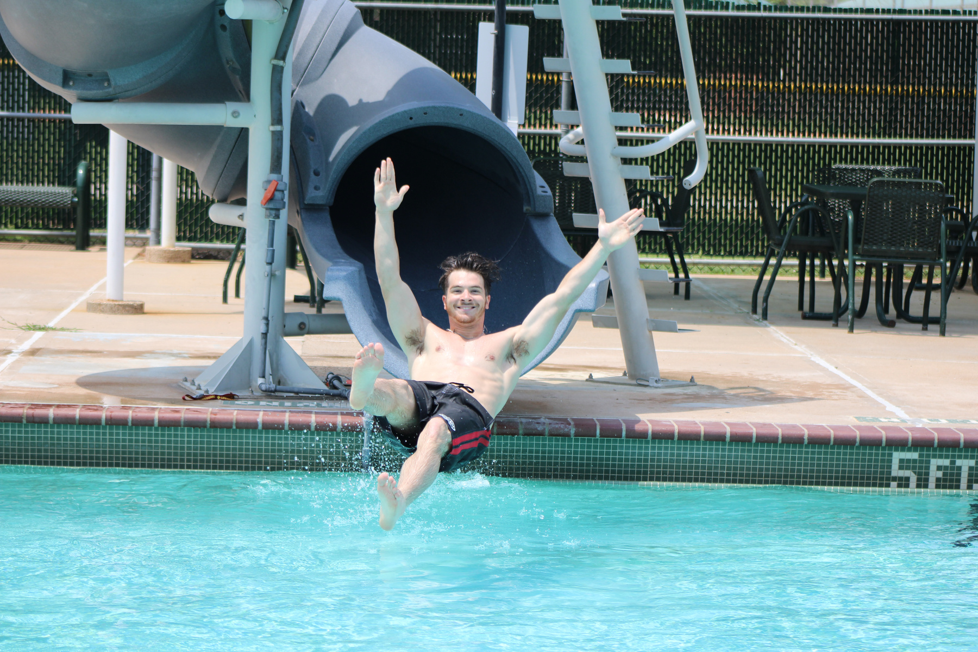
Project Background
The City of Lake Jackson has had an Outdoor Pool since 1949 being the first municipal pool in the county, with Madge Griffith Park also being the oldest park in Lake Jackson being established in 1943.

Slide 3
Outdoor Pool Usage
The Outdoor Pool is utilized for a variety of programs, rentals and daily usage each and every Summer Season (Memorial Day Weekend through Labor Day Weekend) . Programs offered at the Outdoor Pool include: Swim Lessons, Water Aerobics Classes, Monthly Family Swim Nights, Mermaid Makeover and Drool in the Pool. On average the Outdoor Pool receives roughly 10,000 visitors each summer ranging from the various programs and rentals. With the high usage rate of the pool the plaster was in need of repairs to ensure patron safety.

Slide 4
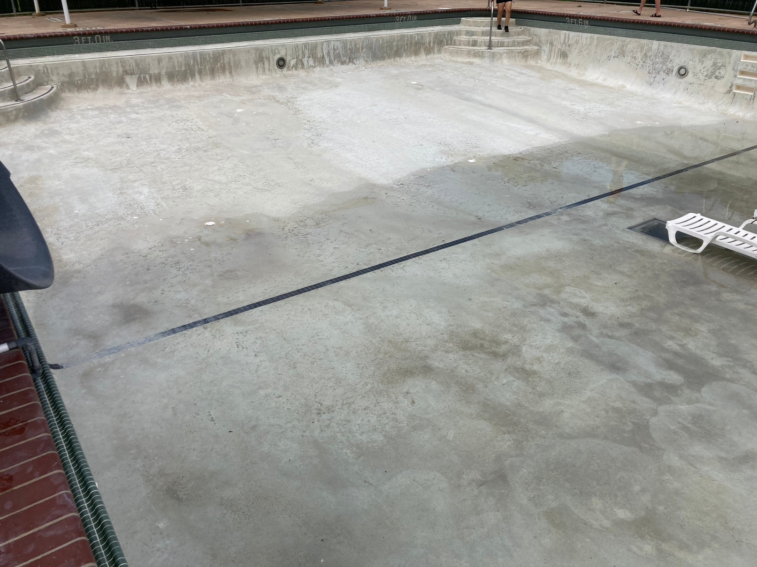
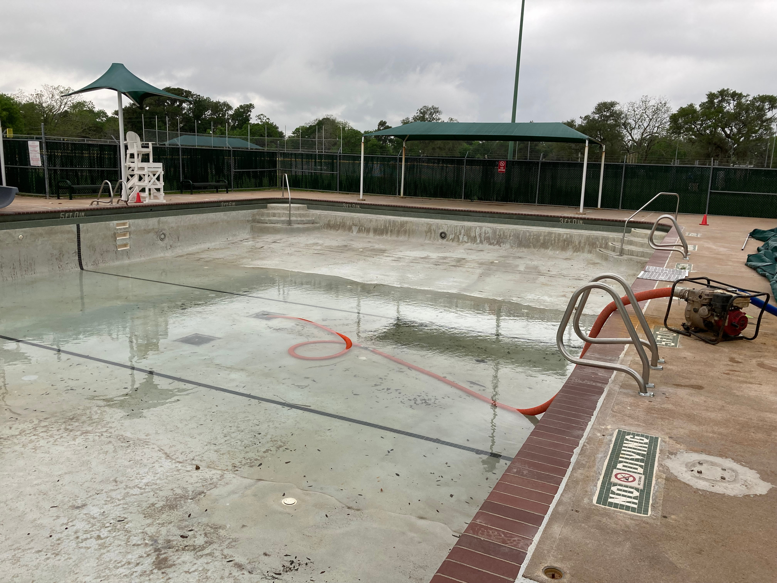
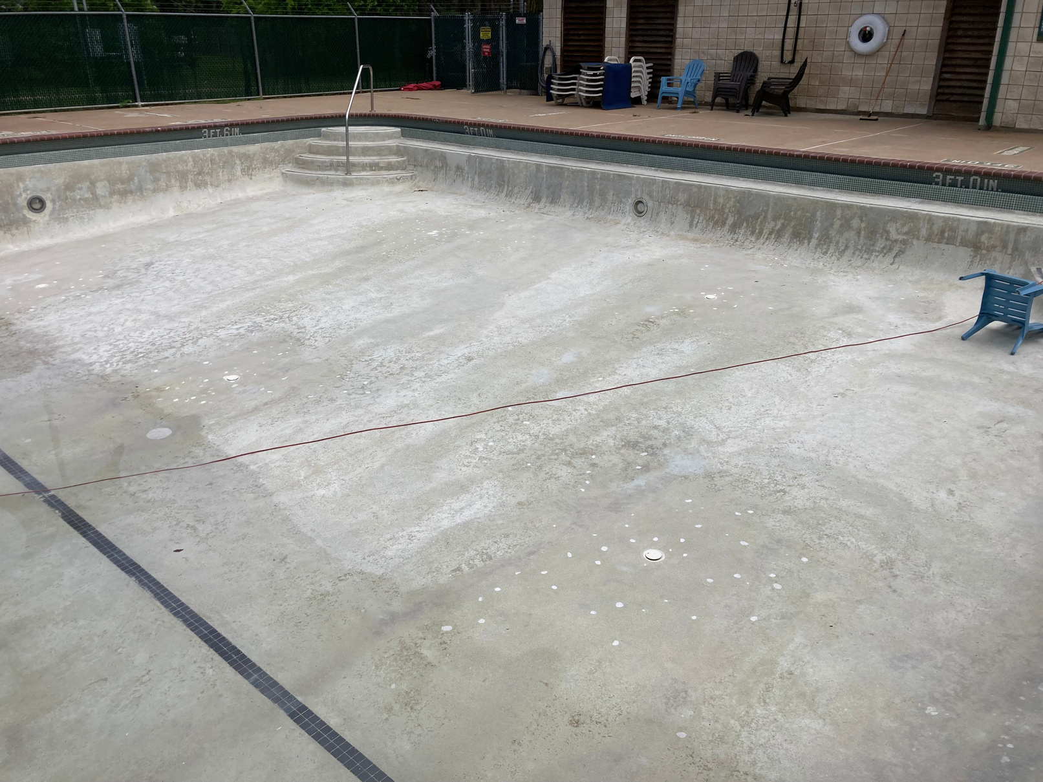
OUTDOOR POOL PLASTER BEFORE

Slide 5
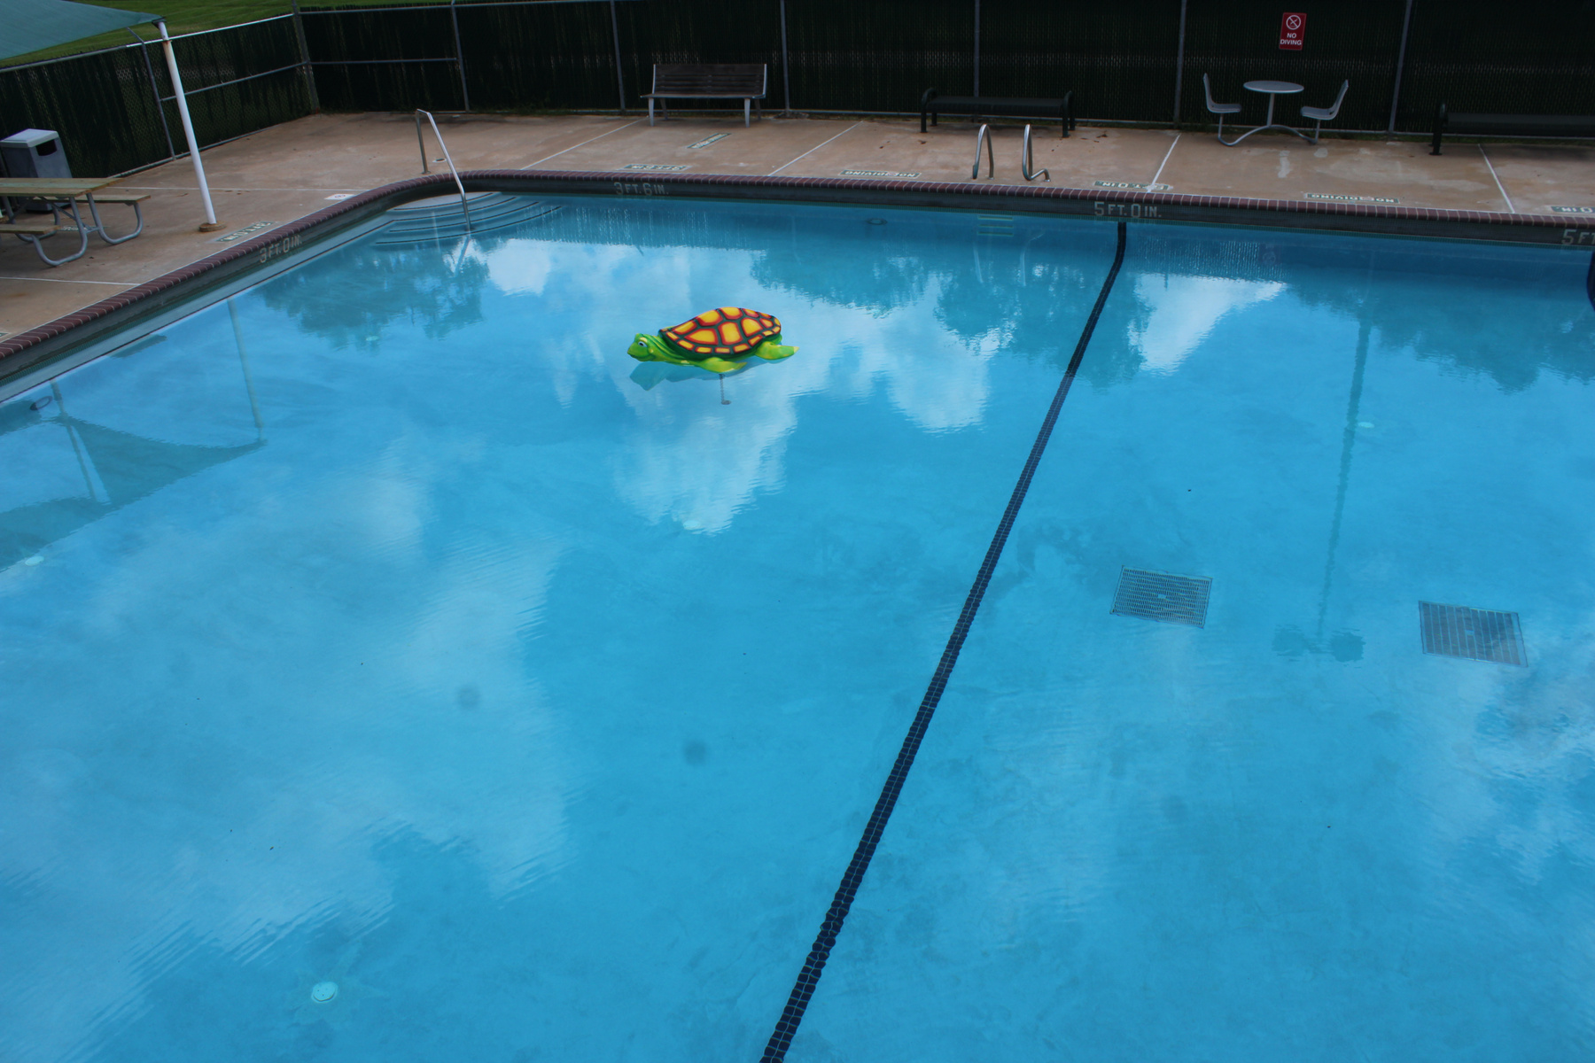
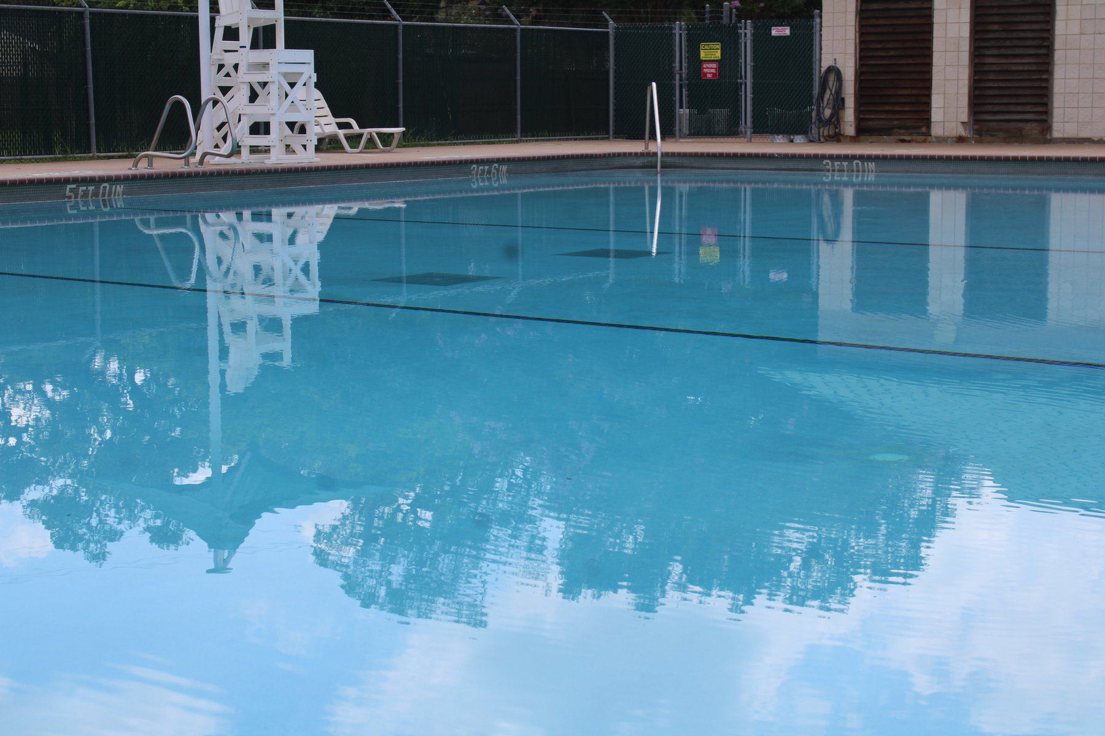
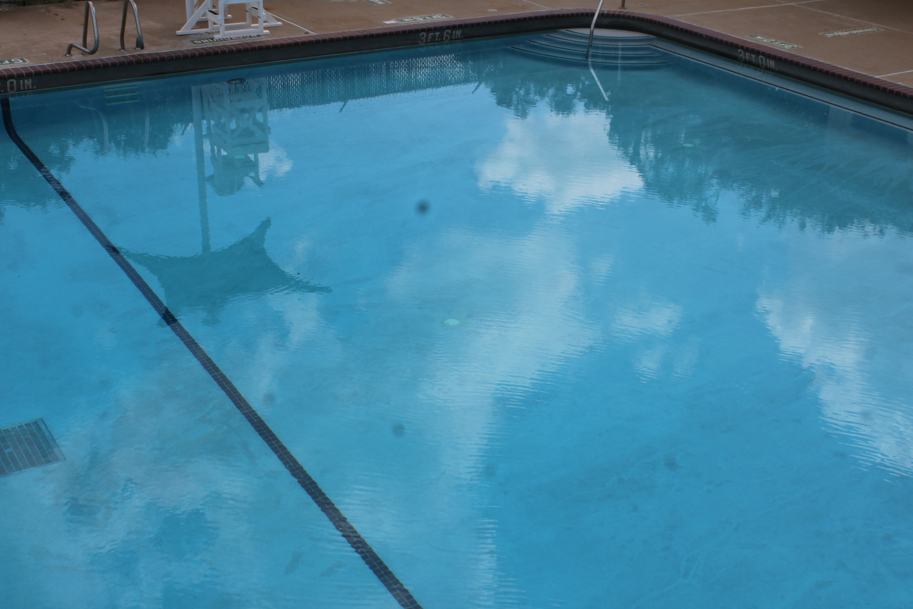
OUTDOOR POOL PLASTER AFTER

Slide 6

Where did the Funding come from?
This project was funded through the Capital Improvement Program (CIP) which comes from the Half-Cent Sales Tax.

