Slide 1
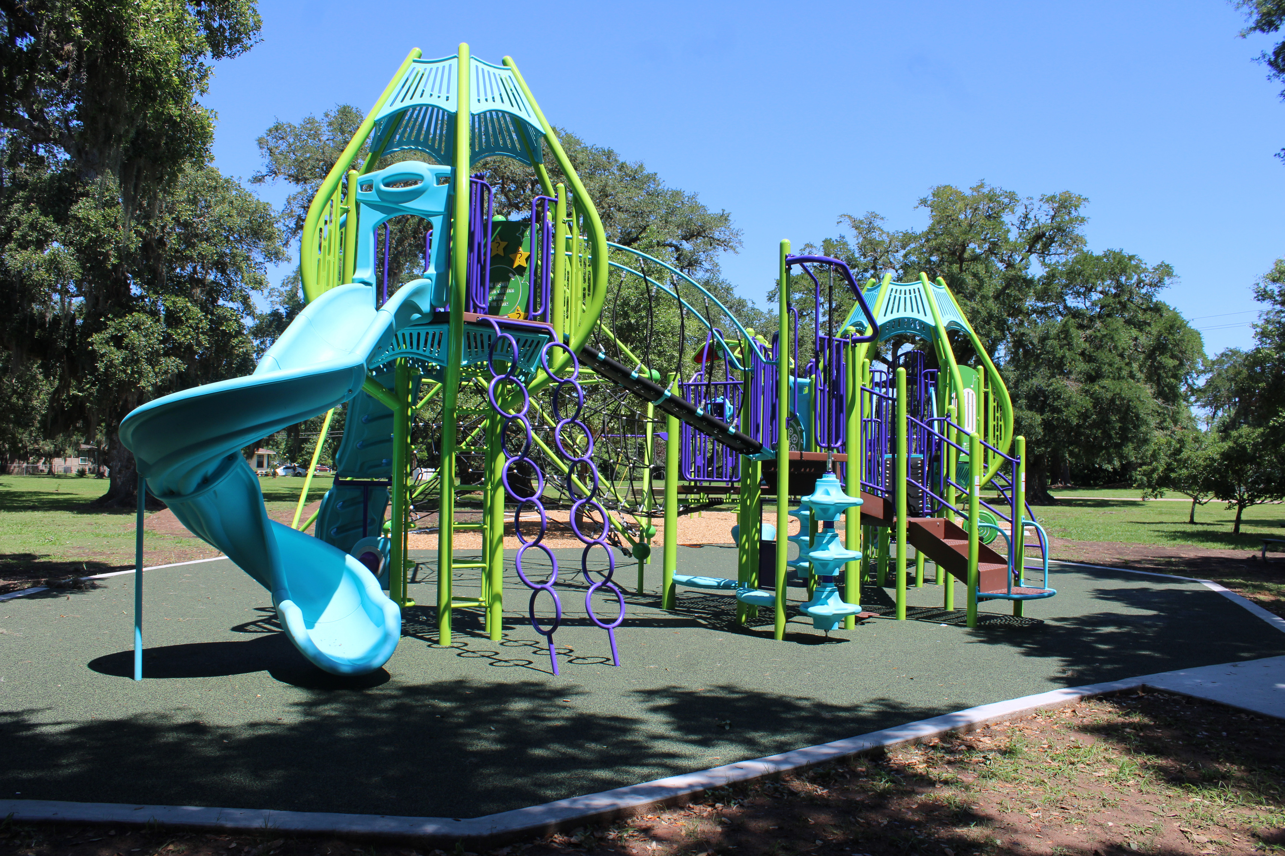

Jasmine Park Playground Renovation

Slide 2
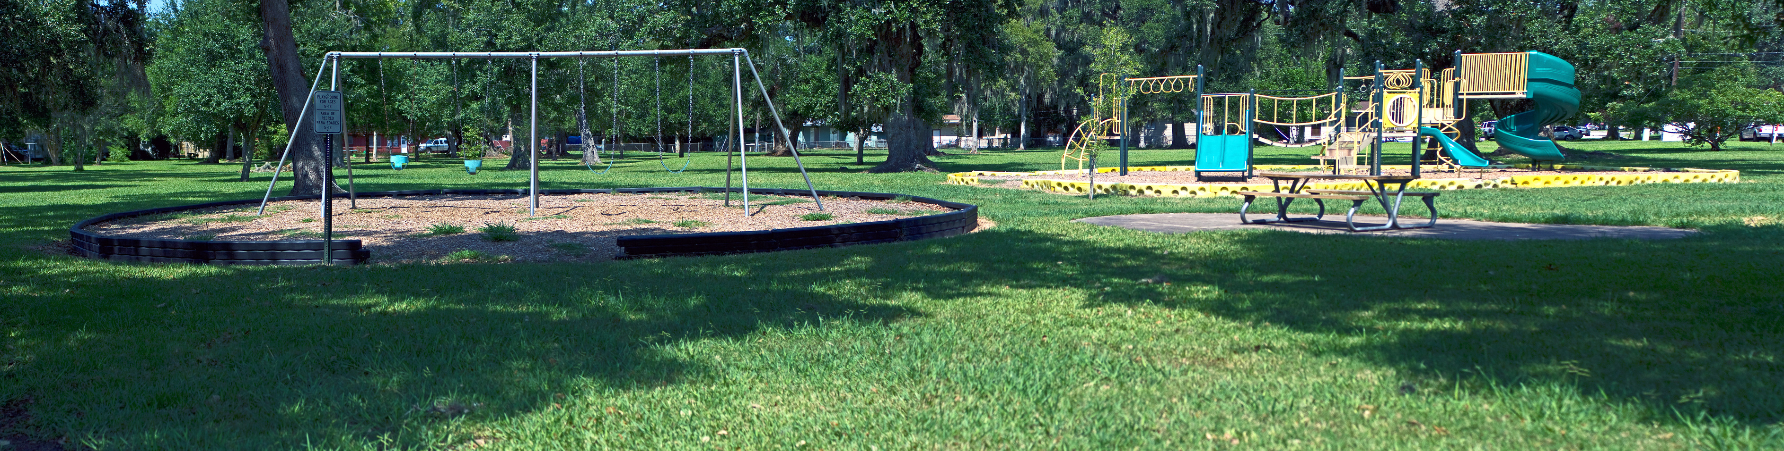
Project Background
Jasmine Park is the second oldest park in Lake Jackson, being established in 1947. The previous playground was installed in 1998 and was in need of replacement. In the 2016 Parks and Recreation Master Plan it was determined that the playground would be a primary focus of replacement for residents, as it is located in an ideal neighborhood containing both passive and active recreation making it a highly utilized park.

Slide 3
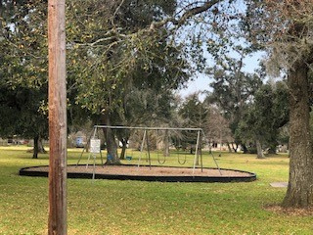
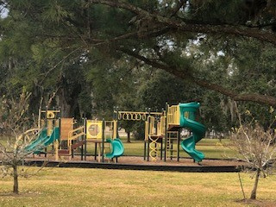
OLD PLAYGROUND

Slide 4
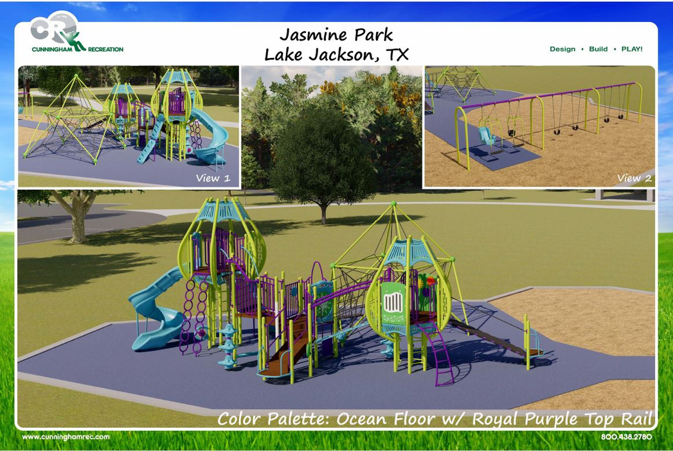
New Playground Design
In 2016 the Parks and Recreation Department conducted a needs assessment of facilities, parkland and amenities through its Parks & Open Space Master Plan. Jasmine Park was listed as one of the parks to have improvements made upon it due to its location and usage. In 2024, the design to the right, was introduced to the Lake Jackson Parks Advisory Board for their approval. Once the design was approved the previous playground was removed and instillation of the new playground began on March 3, 2024, and took approximately 4 weeks to complete. The new playground combined the two separate play areas incorporating a young oak tree, which the designers accounted for its growth so it will have plenty of room to grow, while adding shady areas for the kids to play without being an obstacle. A concrete border was installed around the entire perimeter with poured in place (PIP) safety surfacing under the main play structure and EWF mulch under around the tree and swings. Something different from what we have done in the past was install a PIP path to one set of swings for easy access for those with mobility issues. A 5-foot-wide ADA concrete path leading to the equipment was also installed.

Slide 5

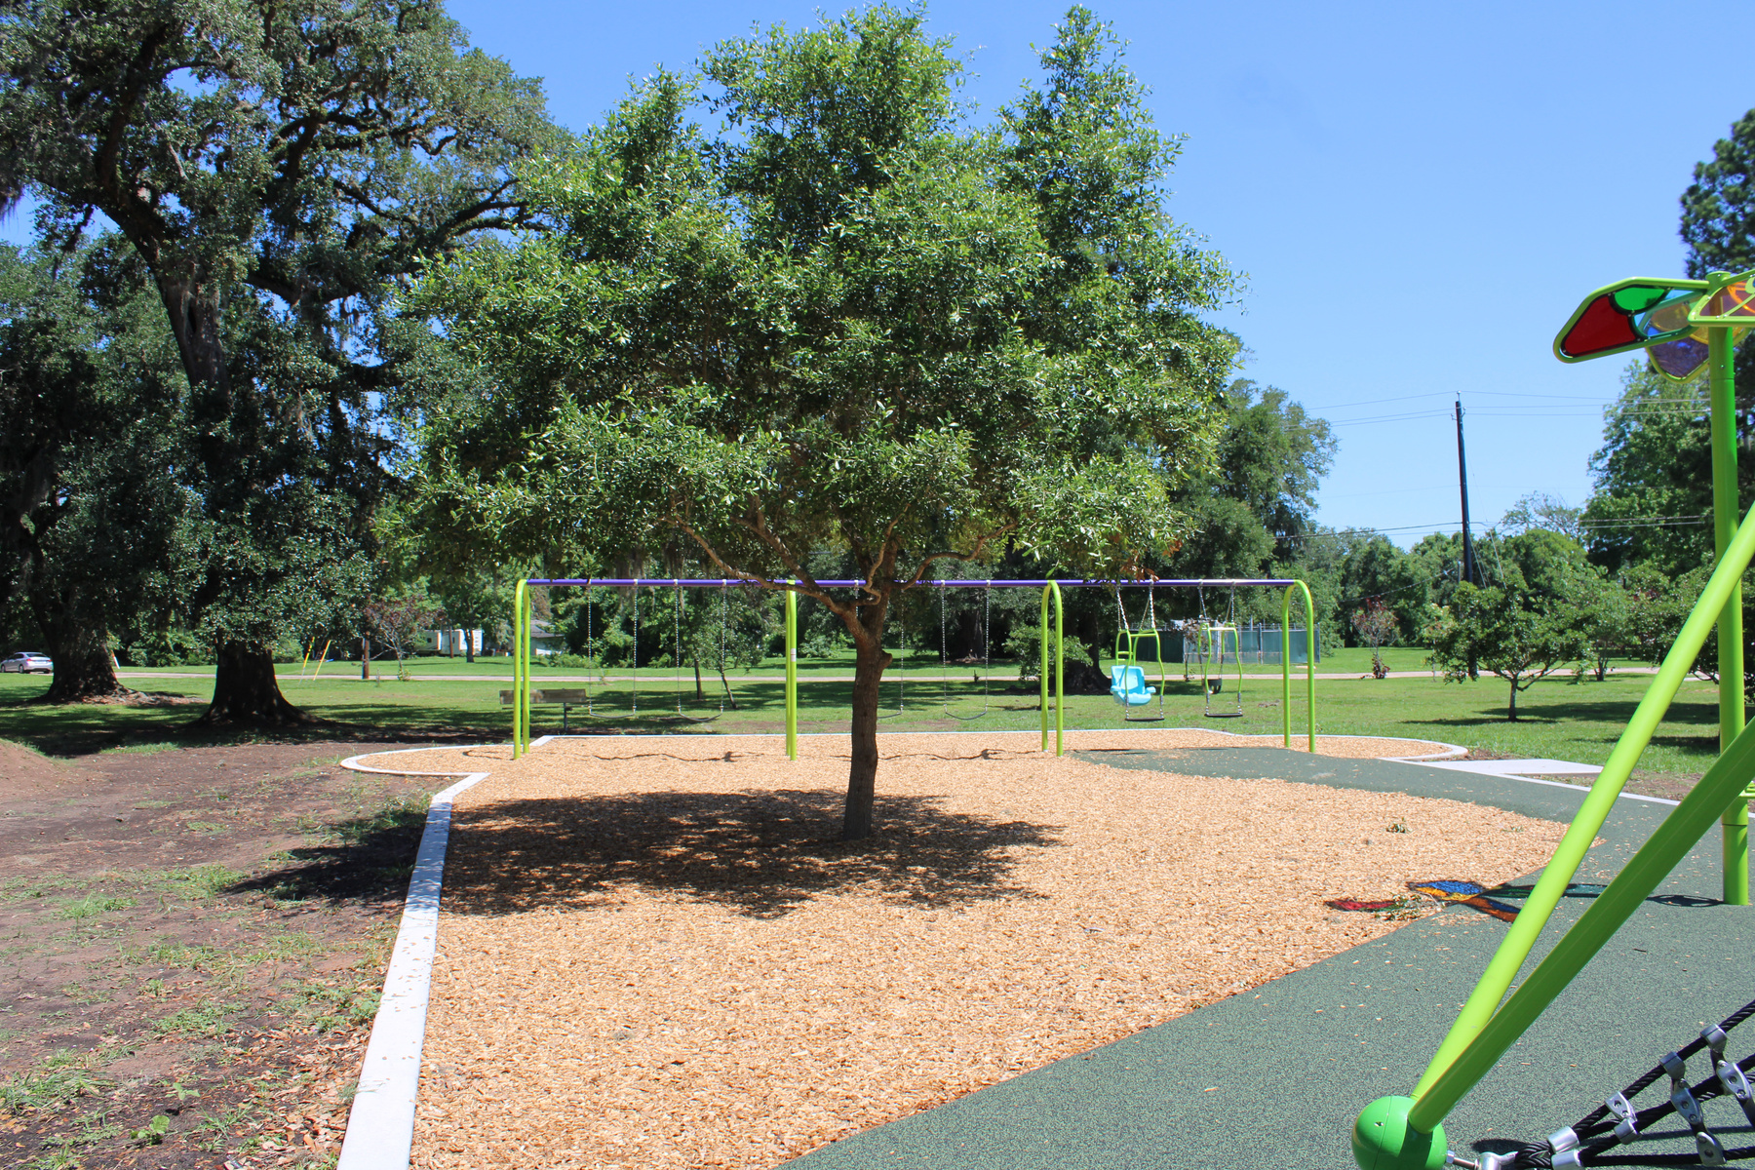
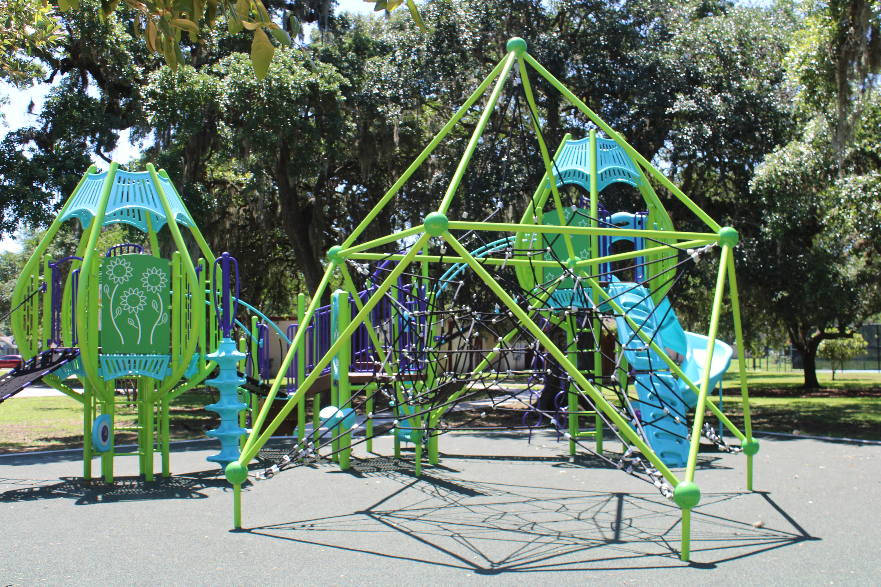
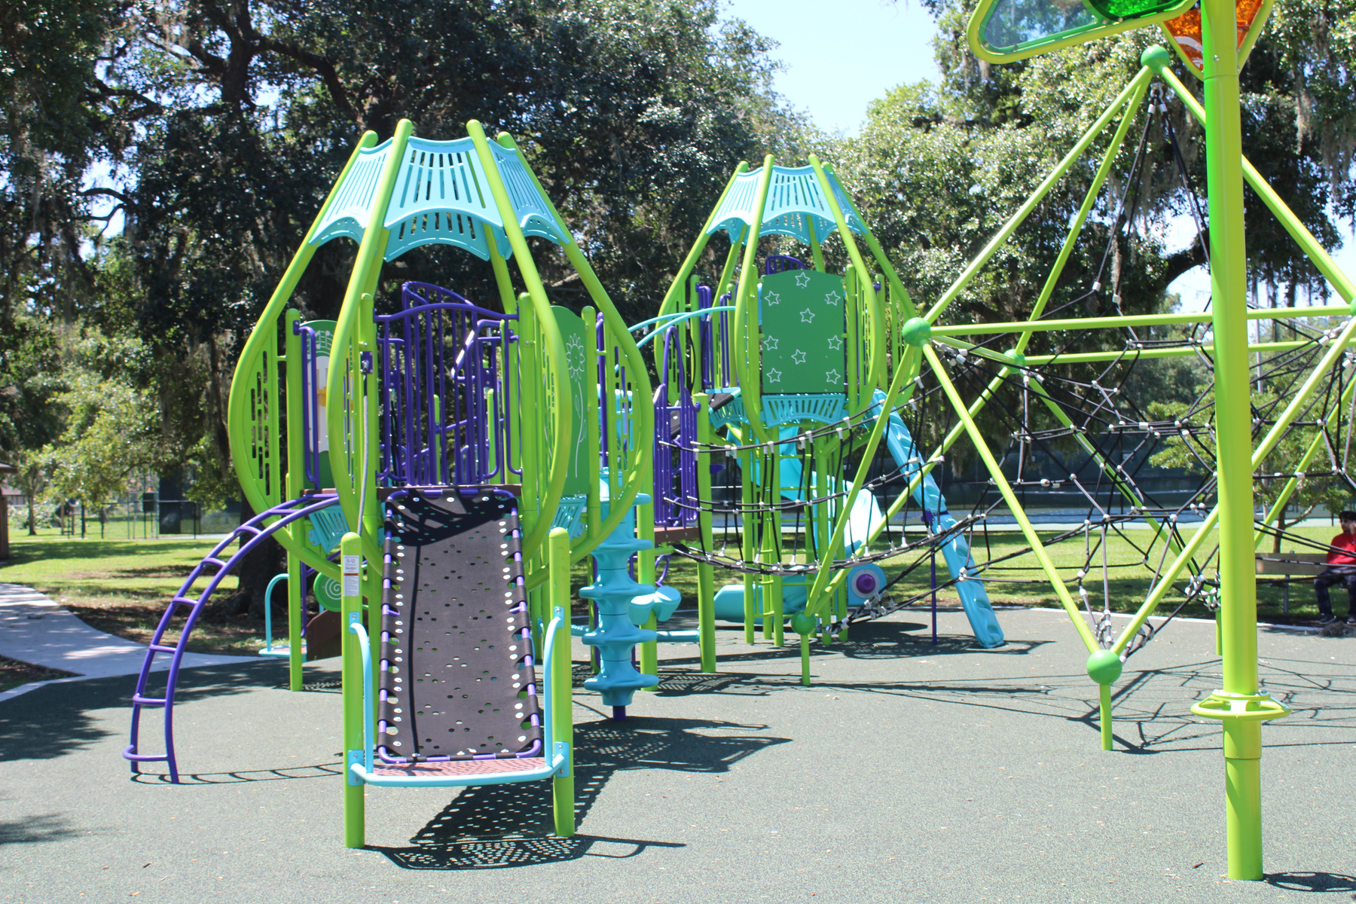
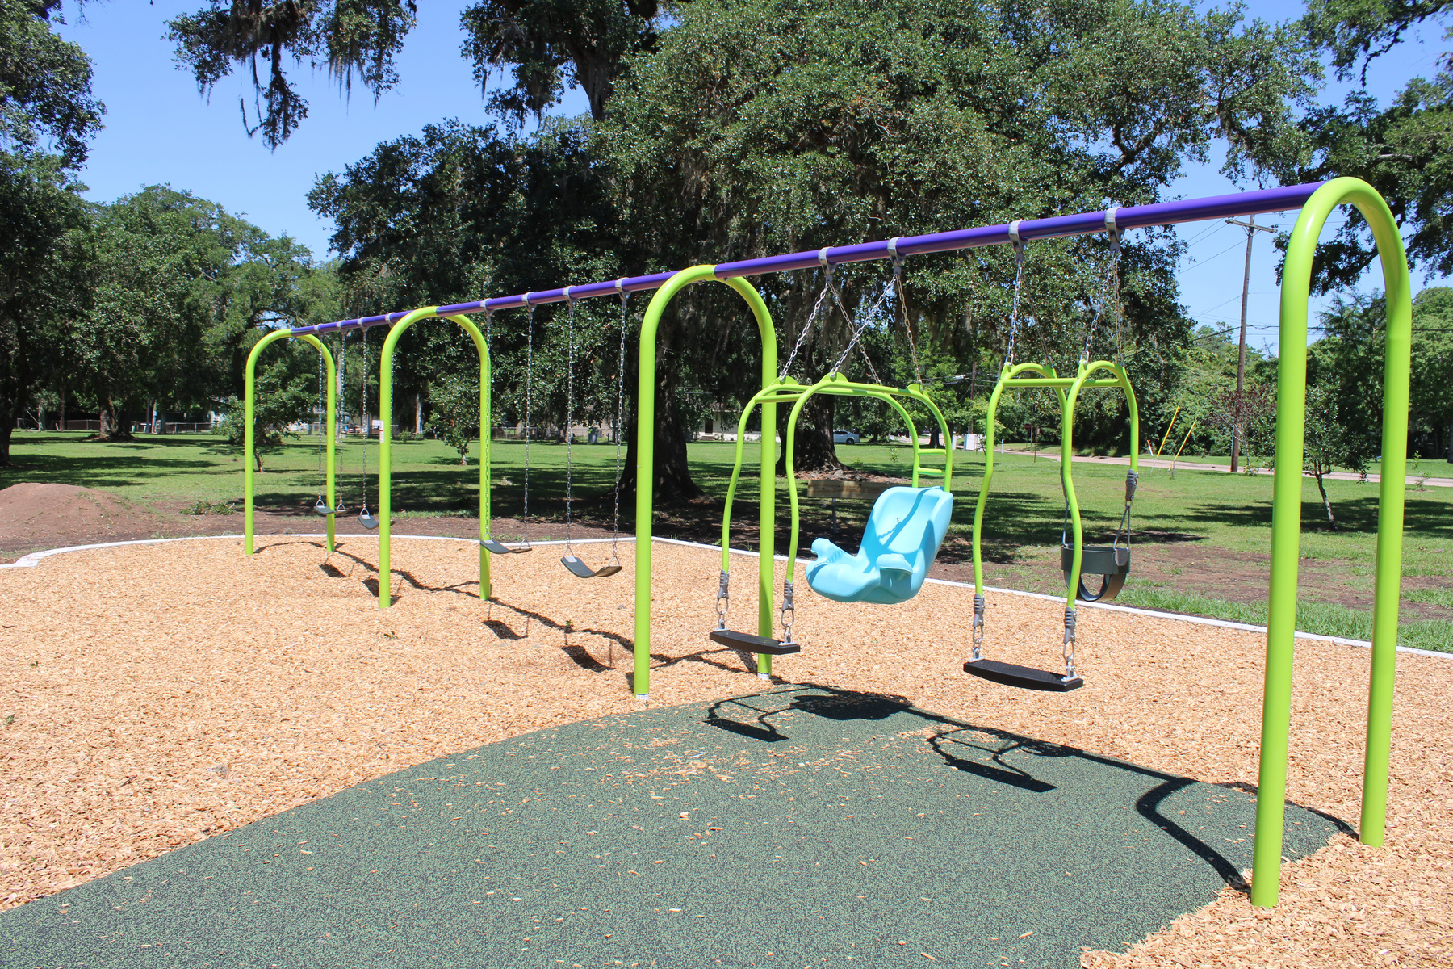
NEW PLAYGROUND EQUIPMENT

Slide 6
Where did the Funding come from?
This project was funded through the Capital Improvement Program (CIP) which comes from the Half-Cent Sales Tax.

