Slide 1
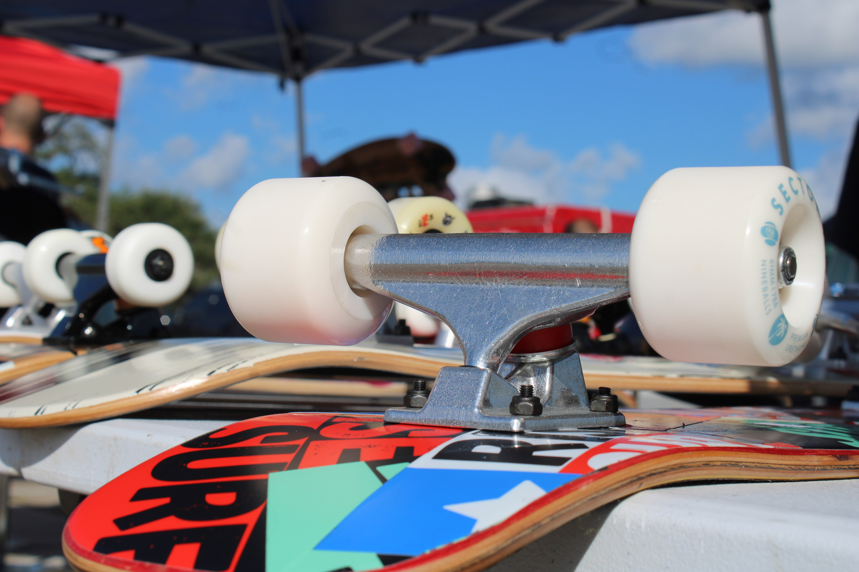

Skate Park

Slide 2
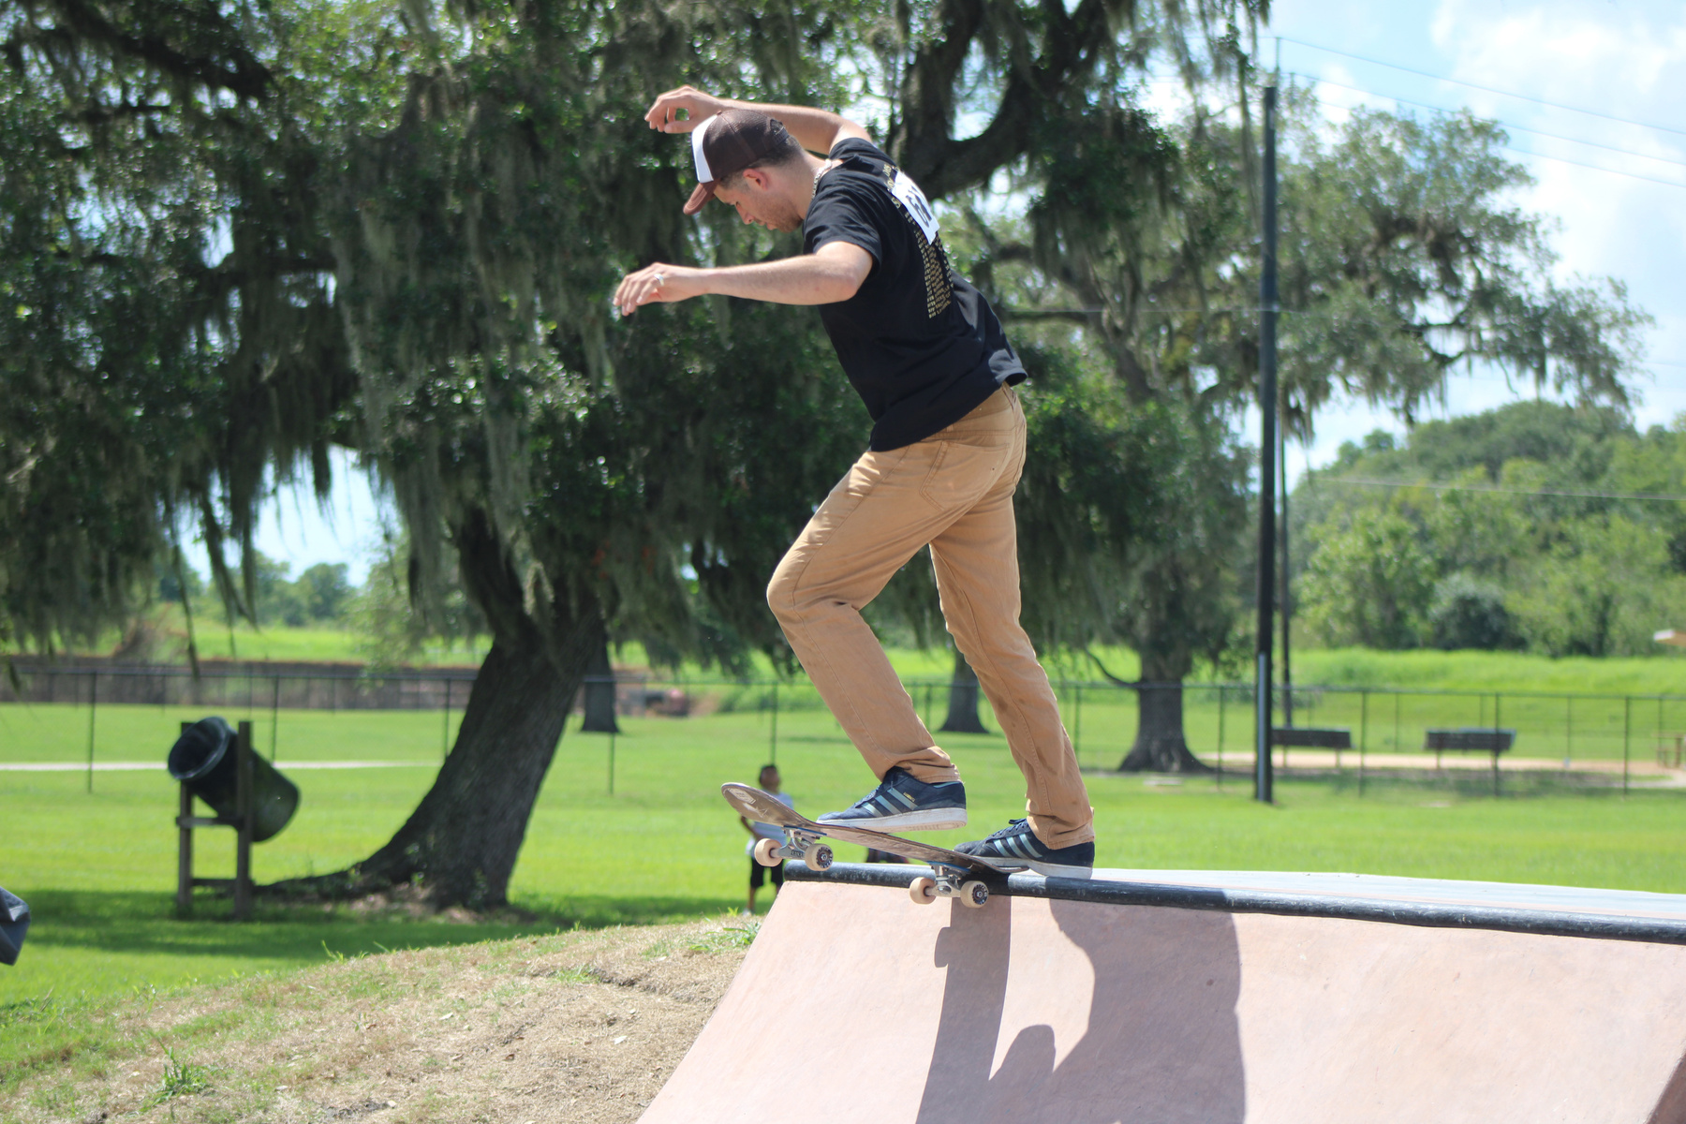
Project Background
The previous Skate Park was installed in October 2001 and was intended to be a temporary structure, however it exceeded City expectations and was a fixture for local skaters and bikers. Upon community hearings it was determined that the construction of a new poured-in place structure was needed for the community. Beginning in 2018 Parks and Recreation Staff met with the community to determine features and specifications that they would like to see included in the City’s new feature.

Slide 3
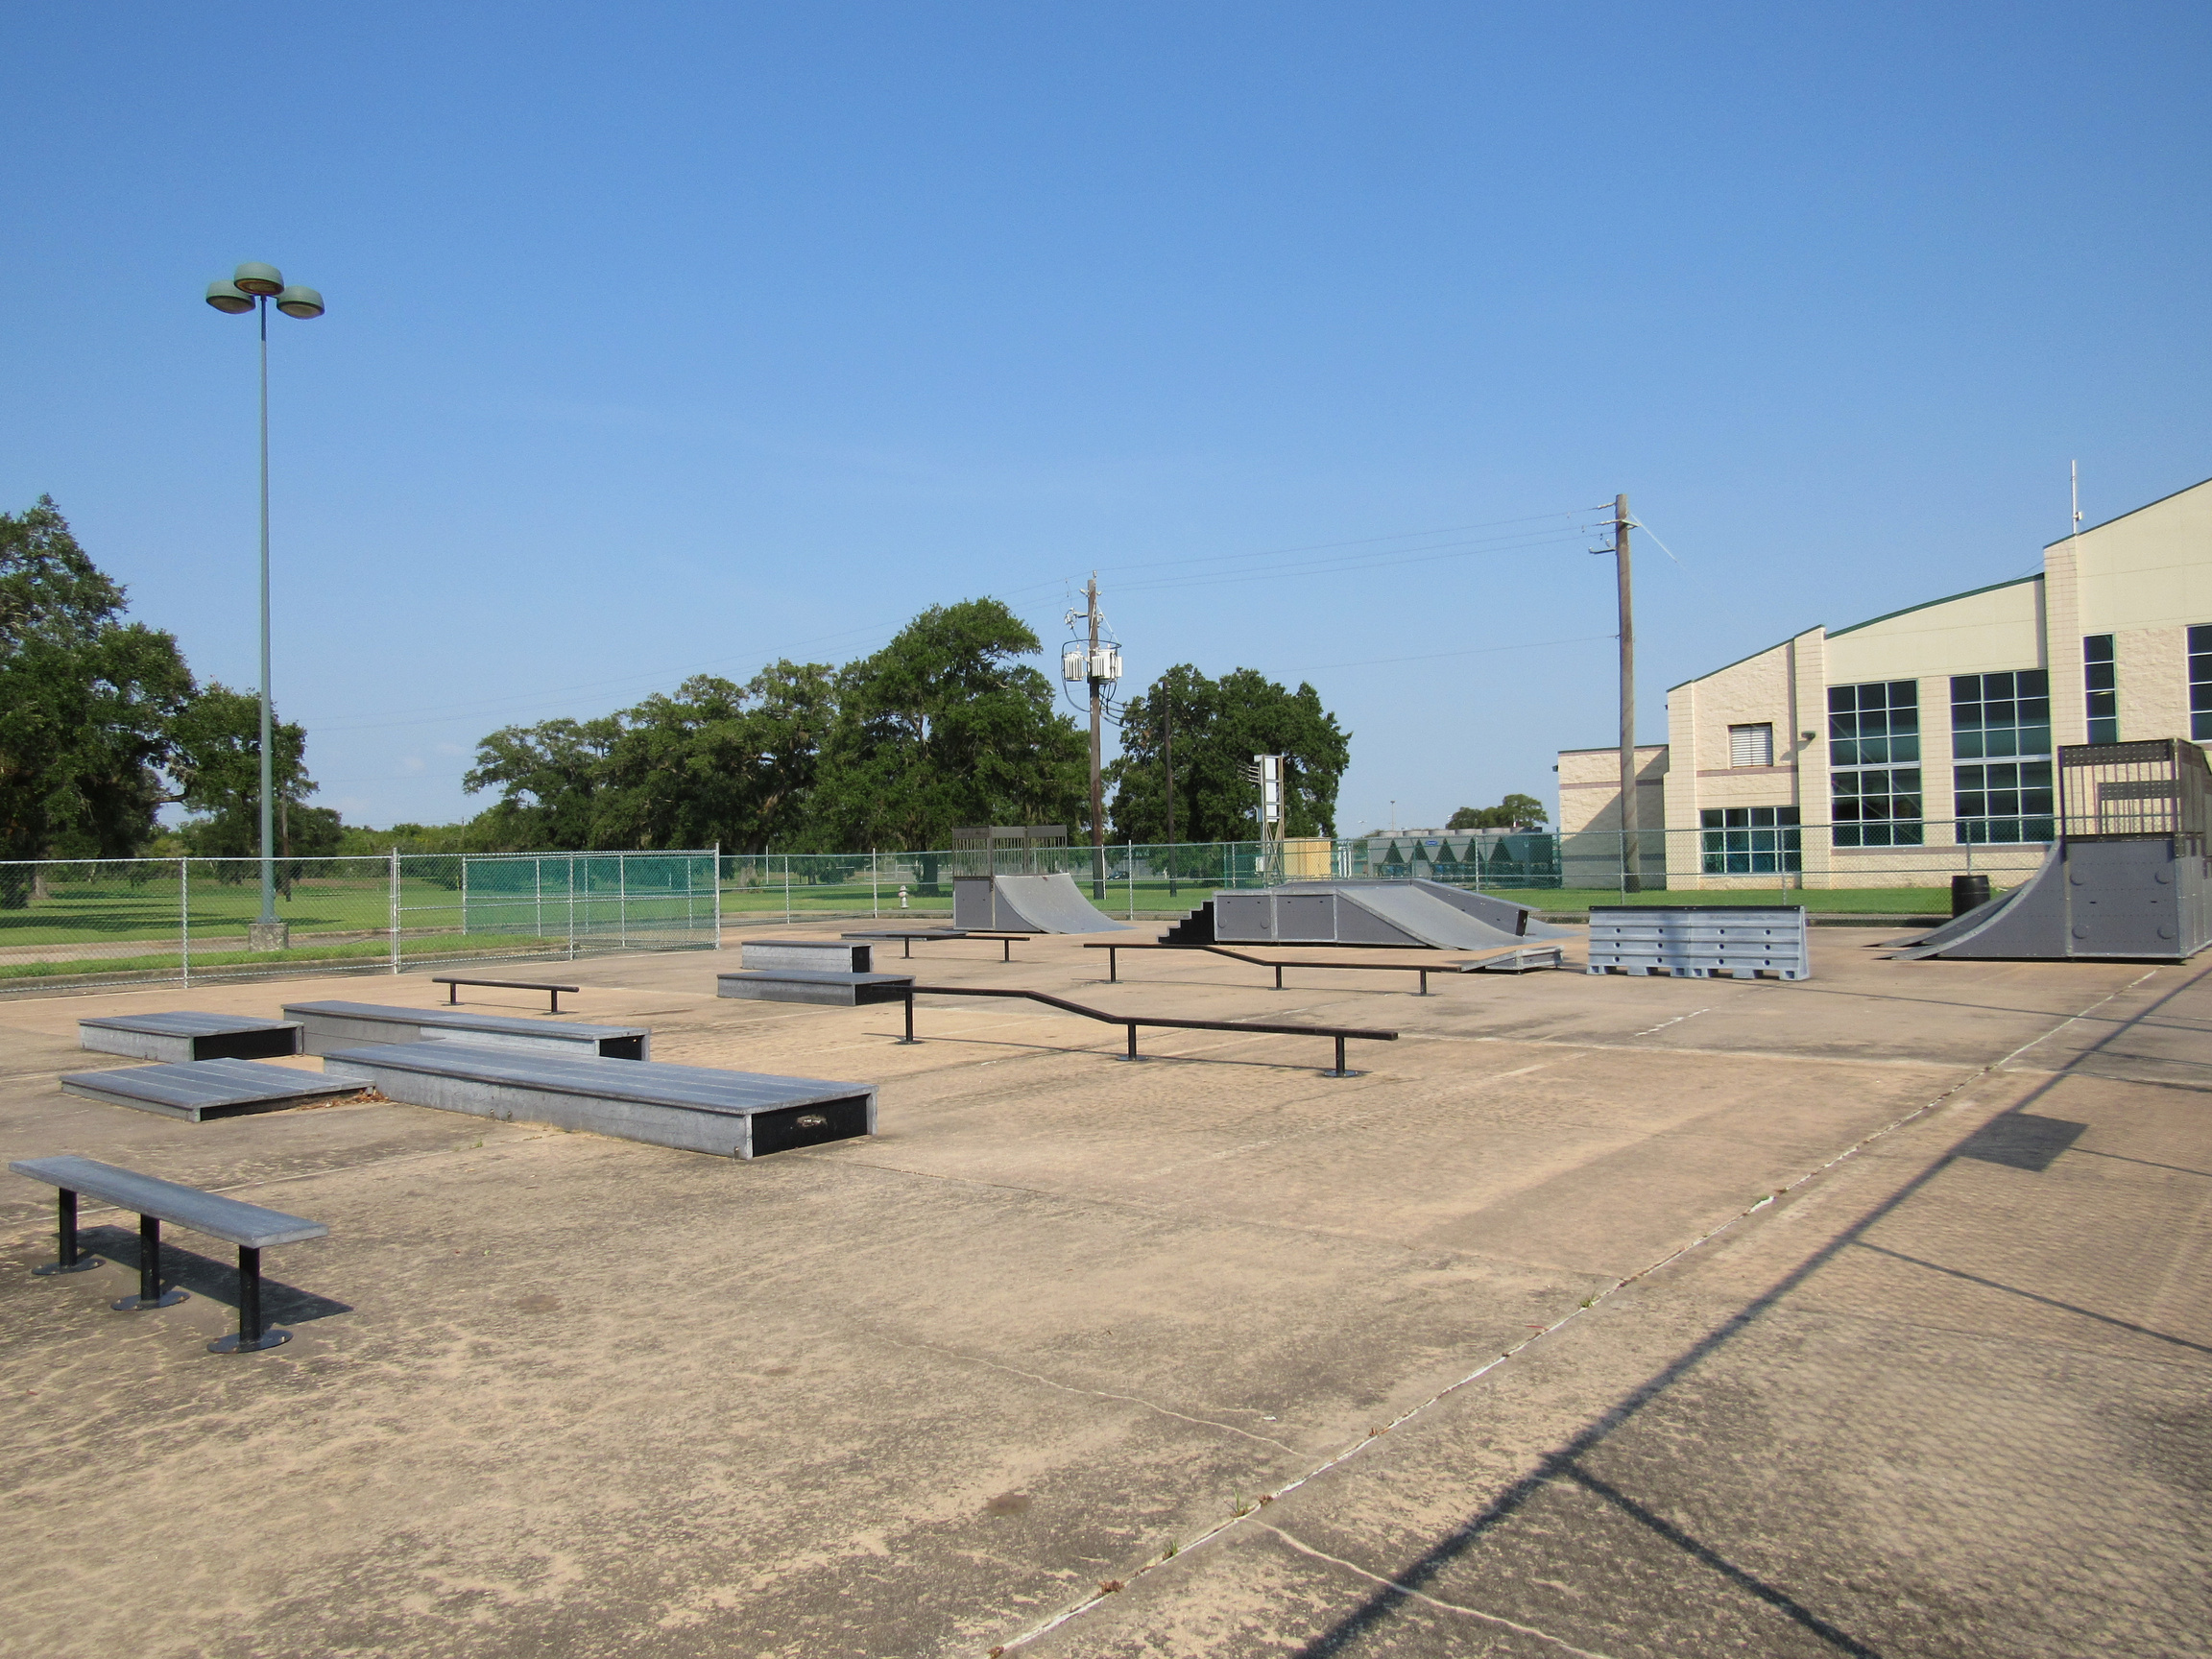
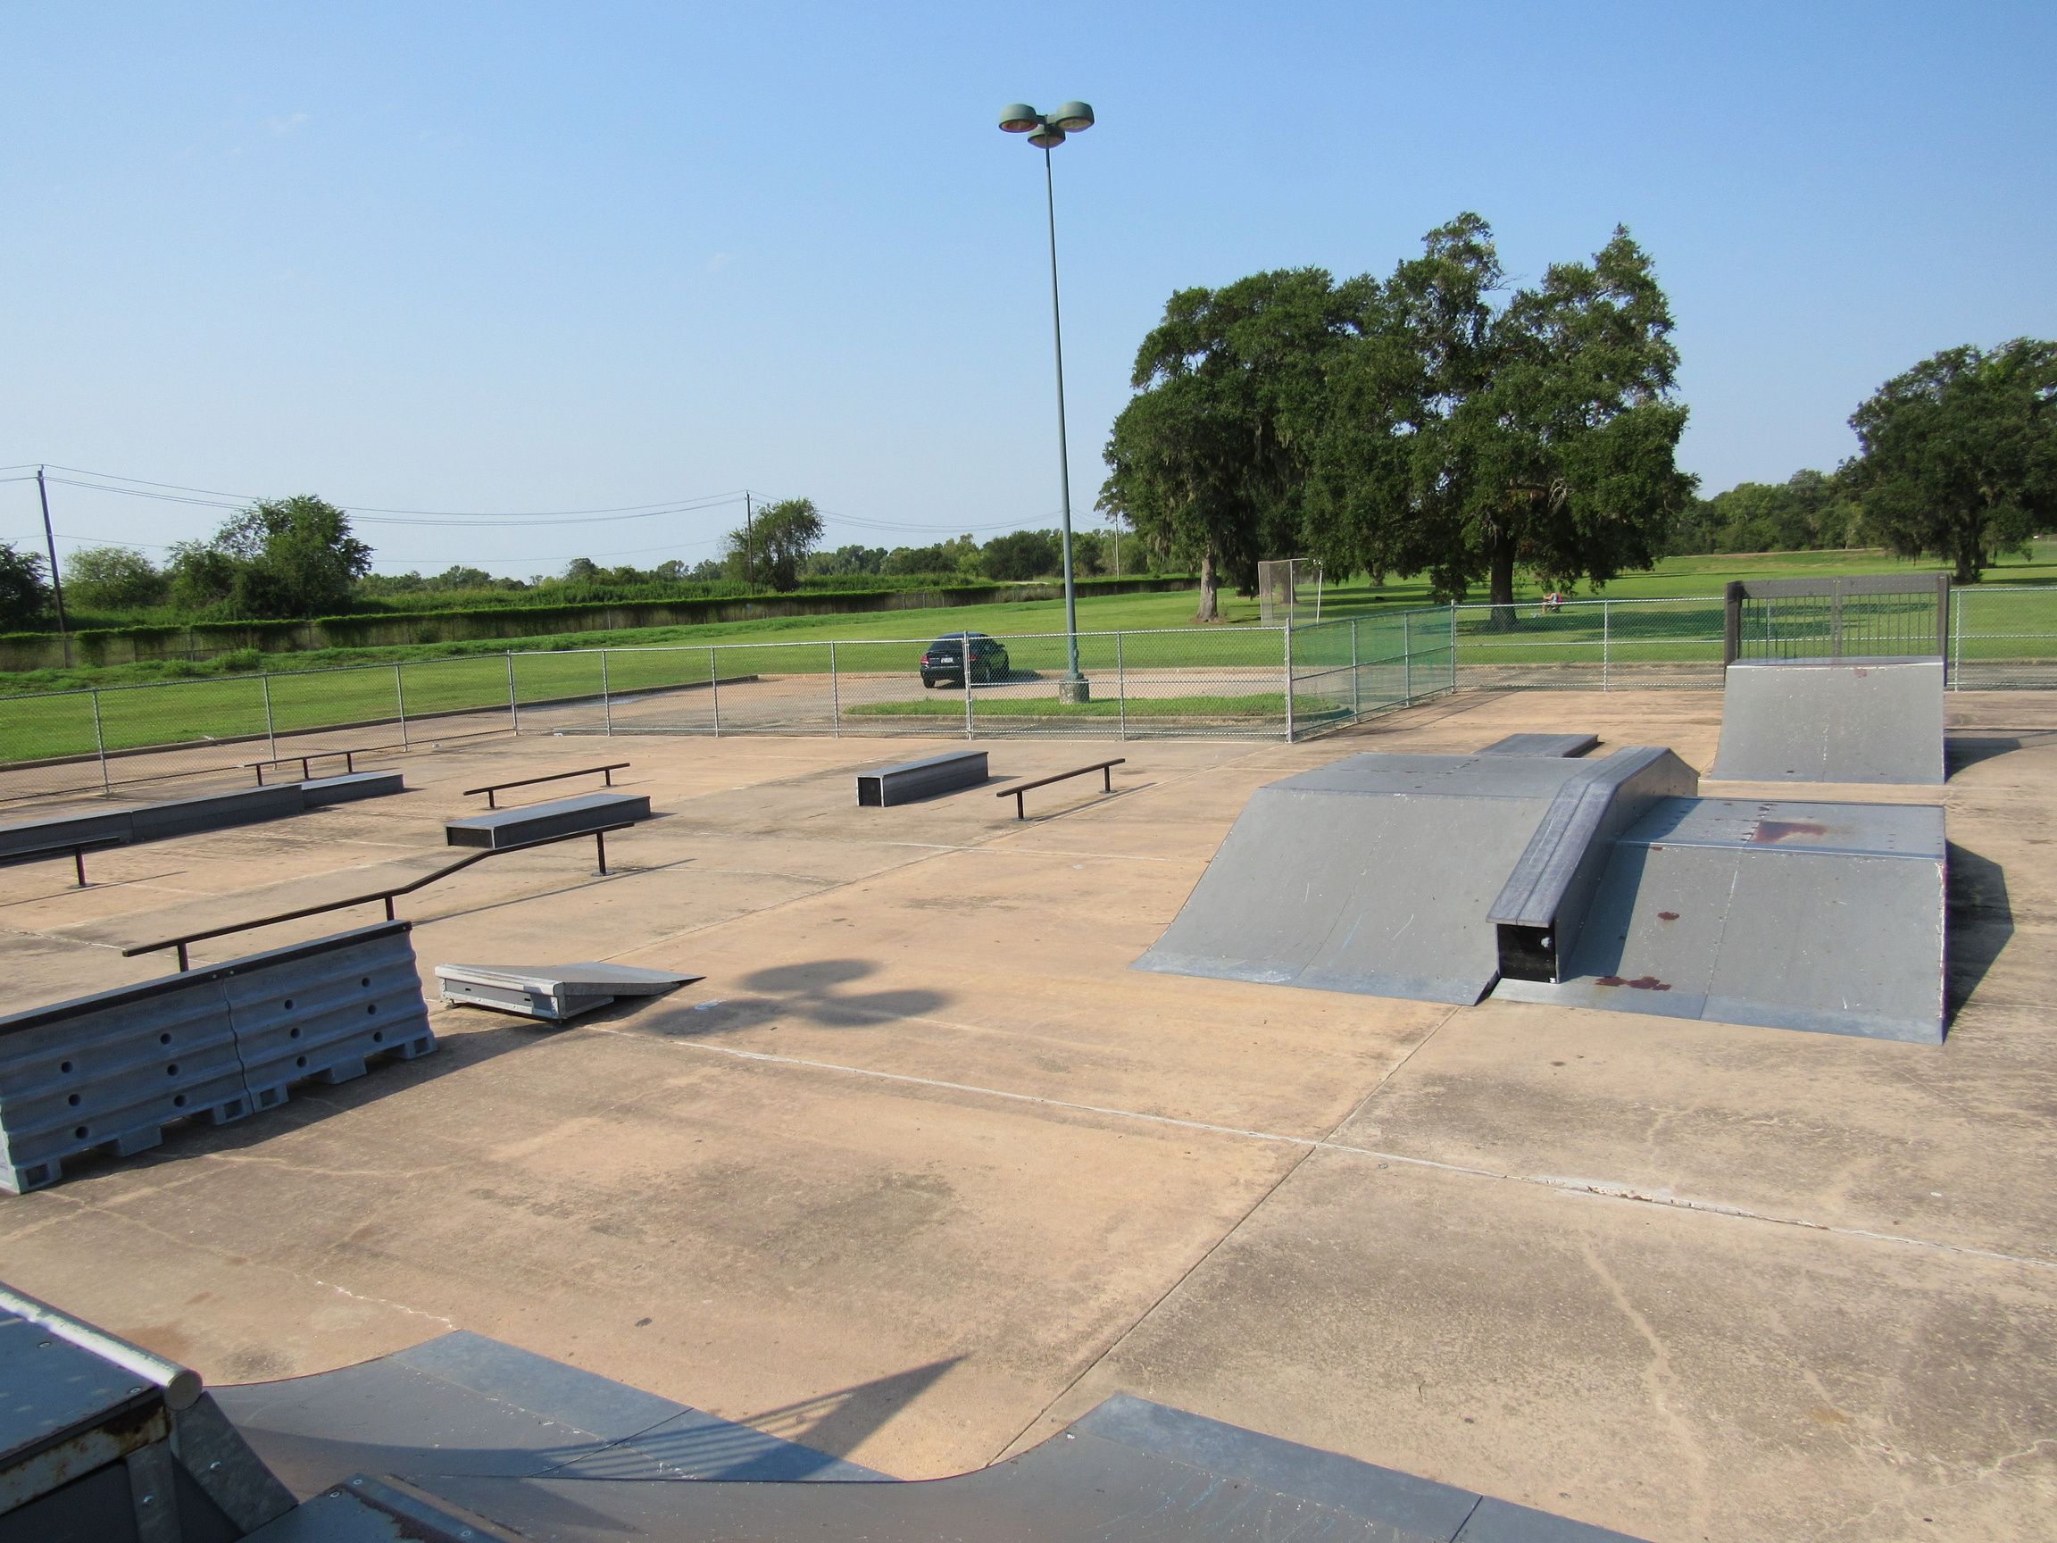
OLD SKATE PARK

Slide 4
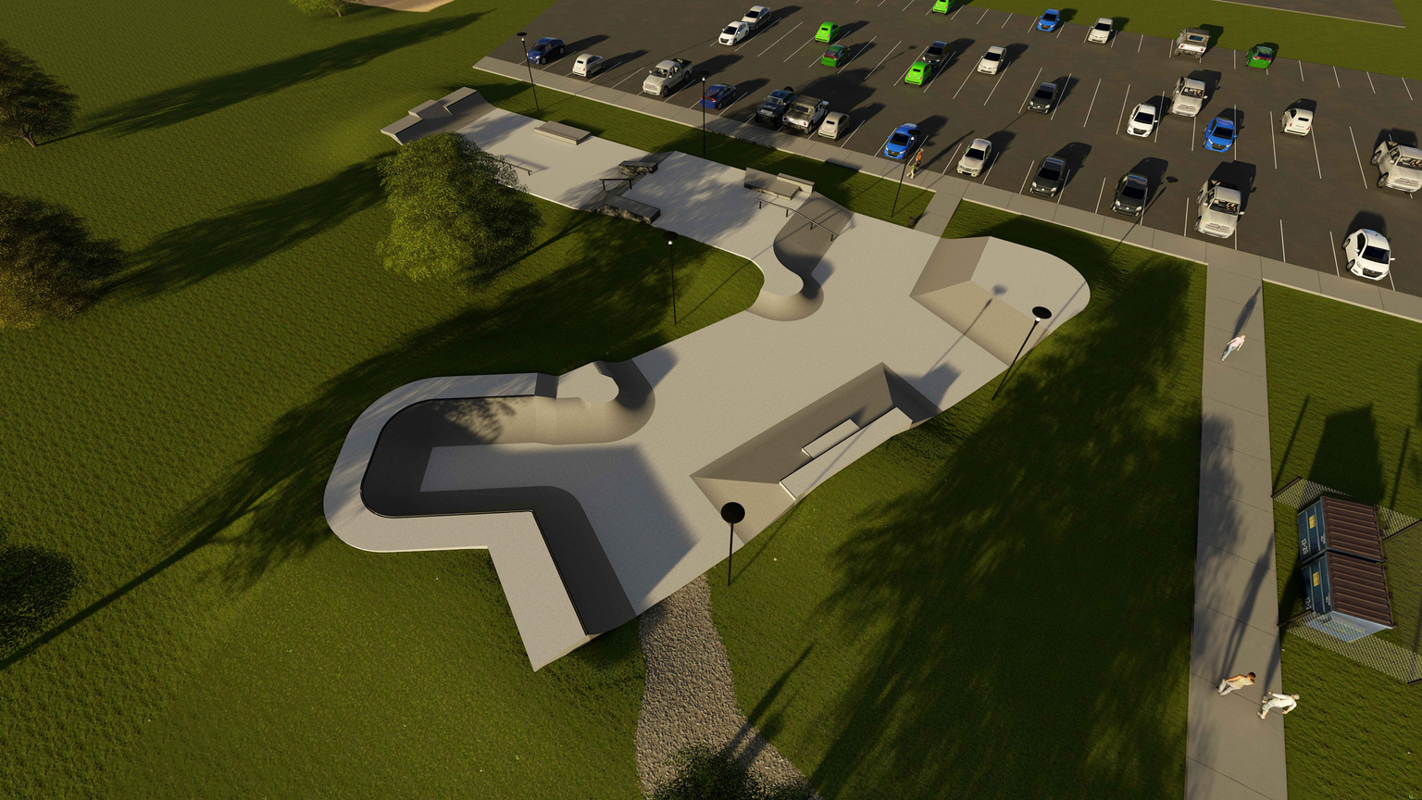
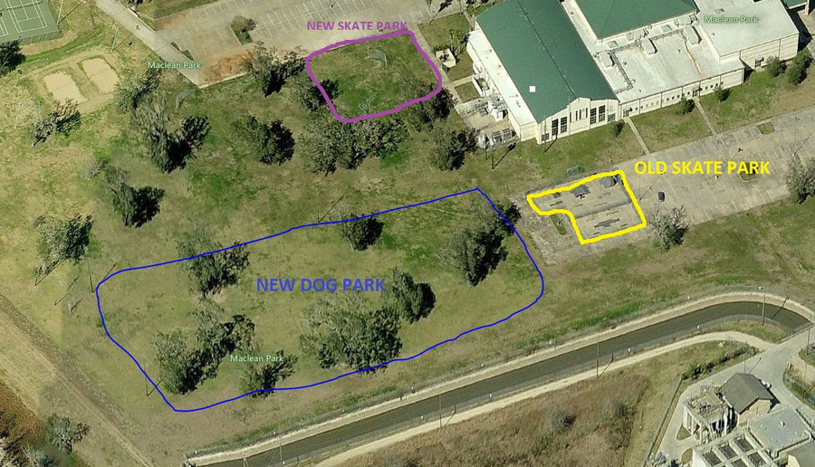
Skate Park Design
In response to the community hearings, Lake Jackson Parks & Recreation partnered with SPA Skateparks to bring this idea to reality. Attached are the conceptual designs that highlighted the needs we received from the local skating community. Groundbreaking on this project began on March 14, 2022 and was expected to be completed in October of 2022, however construction was completed by the end of June due to the builders not experiencing any supply shortages or rain delays. The Grand Opening Ceremony of the MacLean Skate Park occurred on September 17, 2022, with Mayor, members of council and representatives from SPA in attendance. Once the Grand Opening Ceremony and Ribbon Cutting was completed a trick competition took place with judging being conducted from Rise Surf Shop and Gear Skateboards.

Slide 5
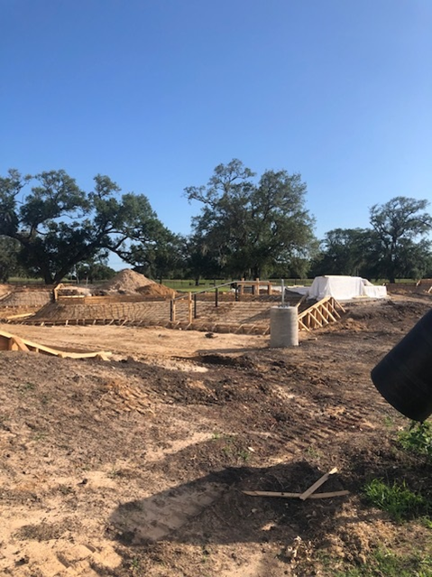
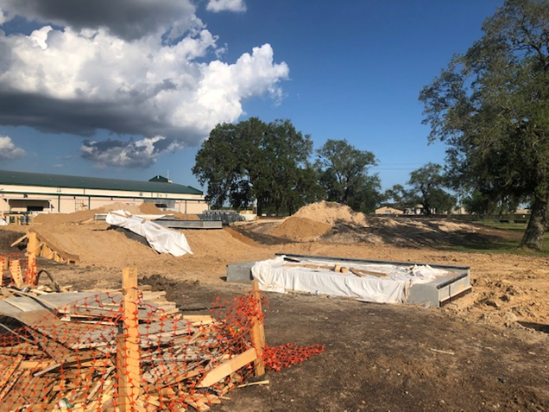
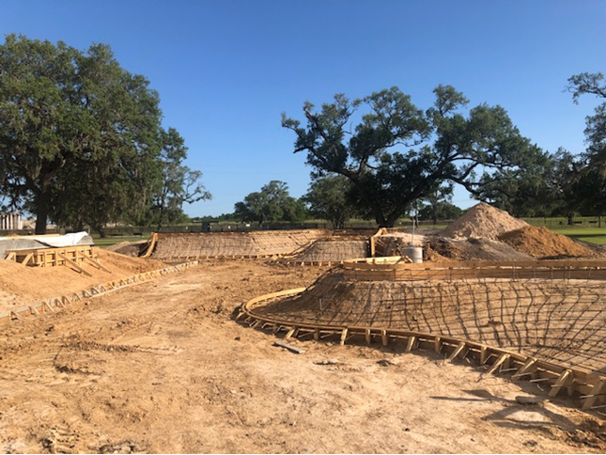
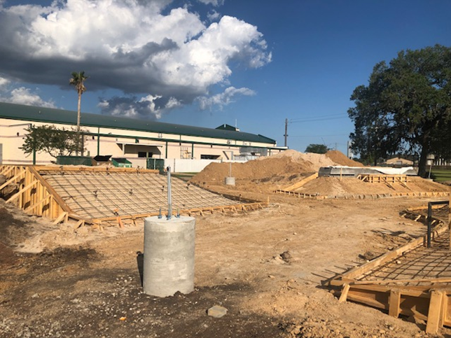
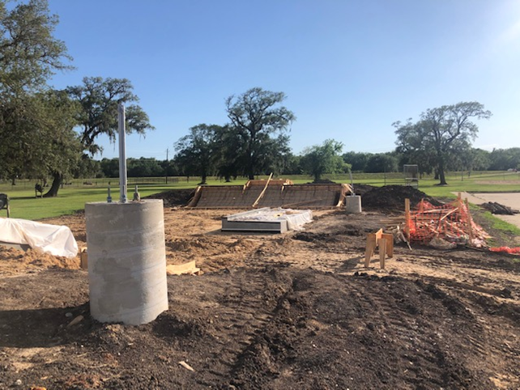
CONSTRUCTION OF THE NEW SKATE PARK

Slide 6
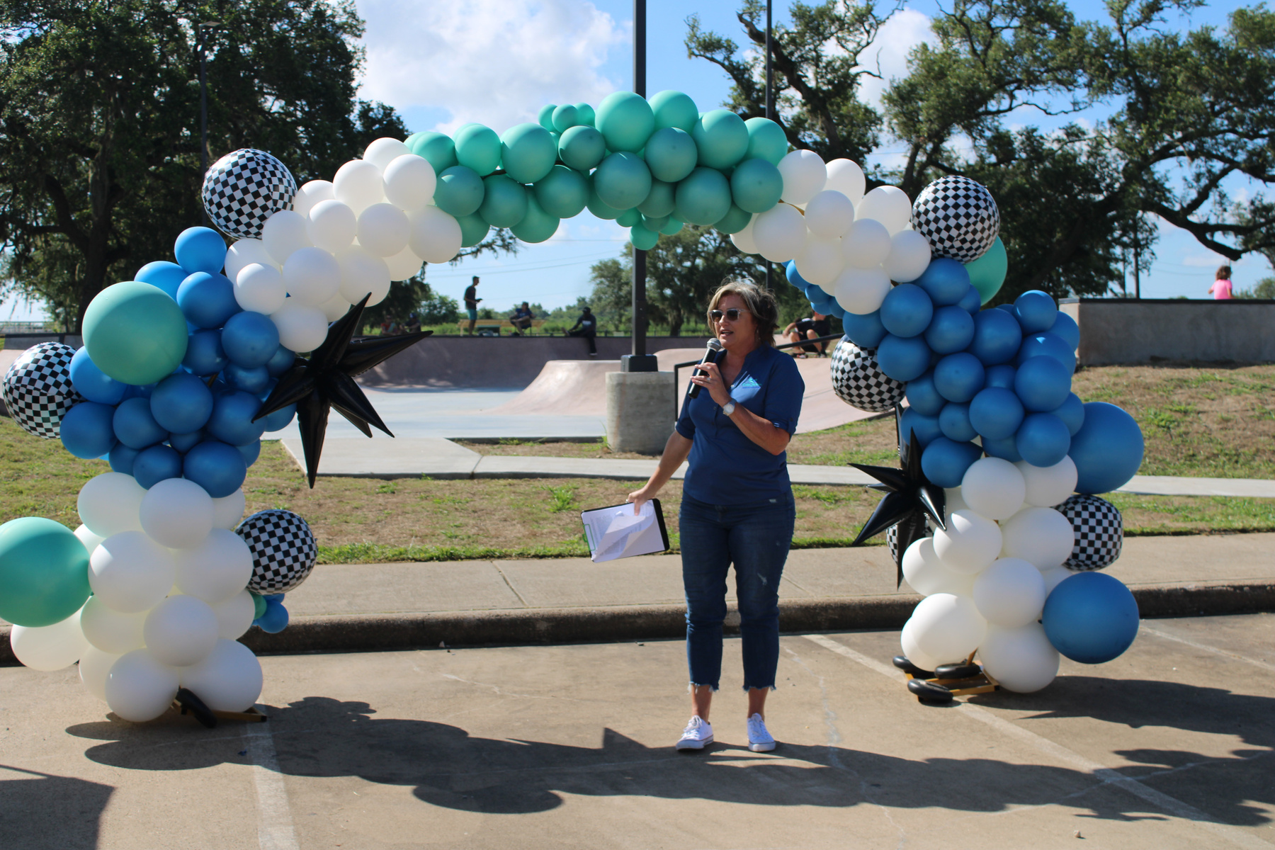
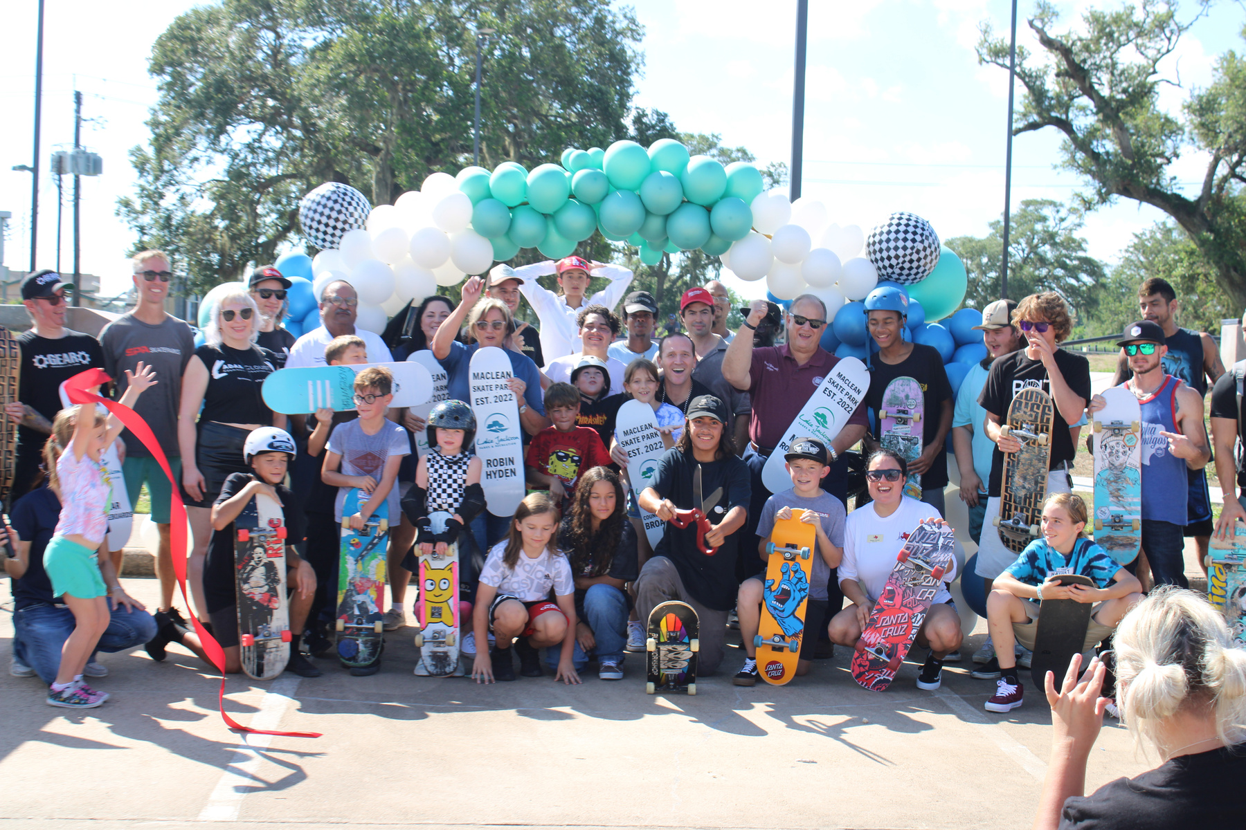
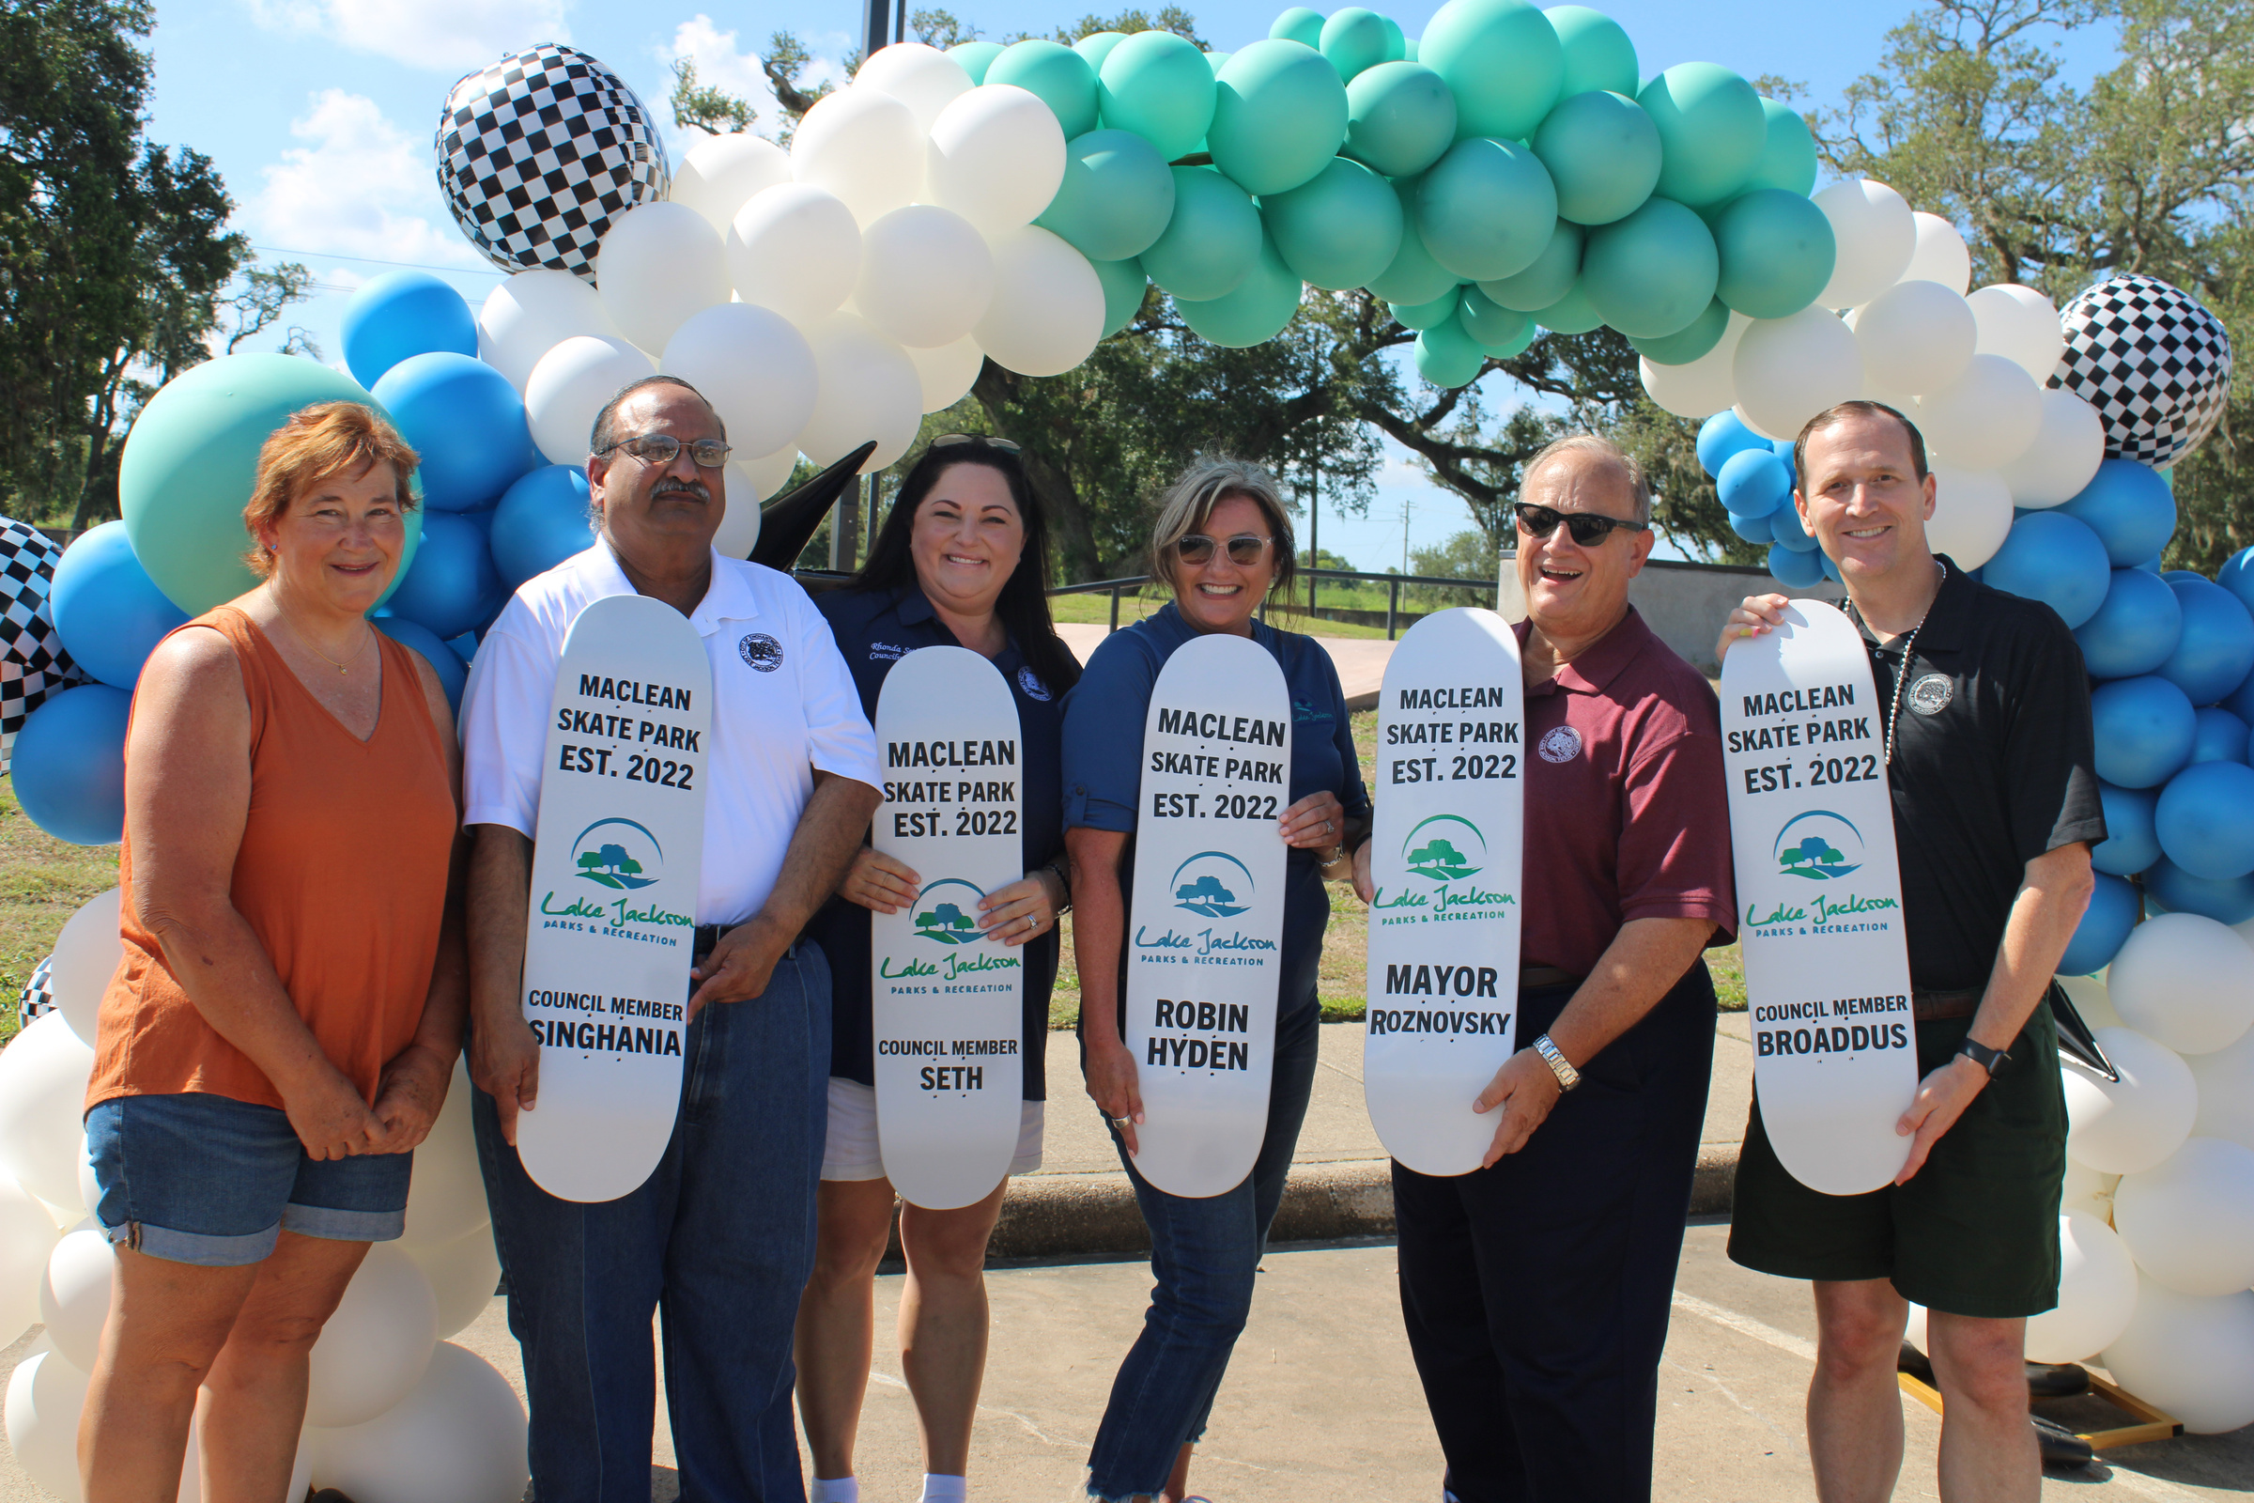
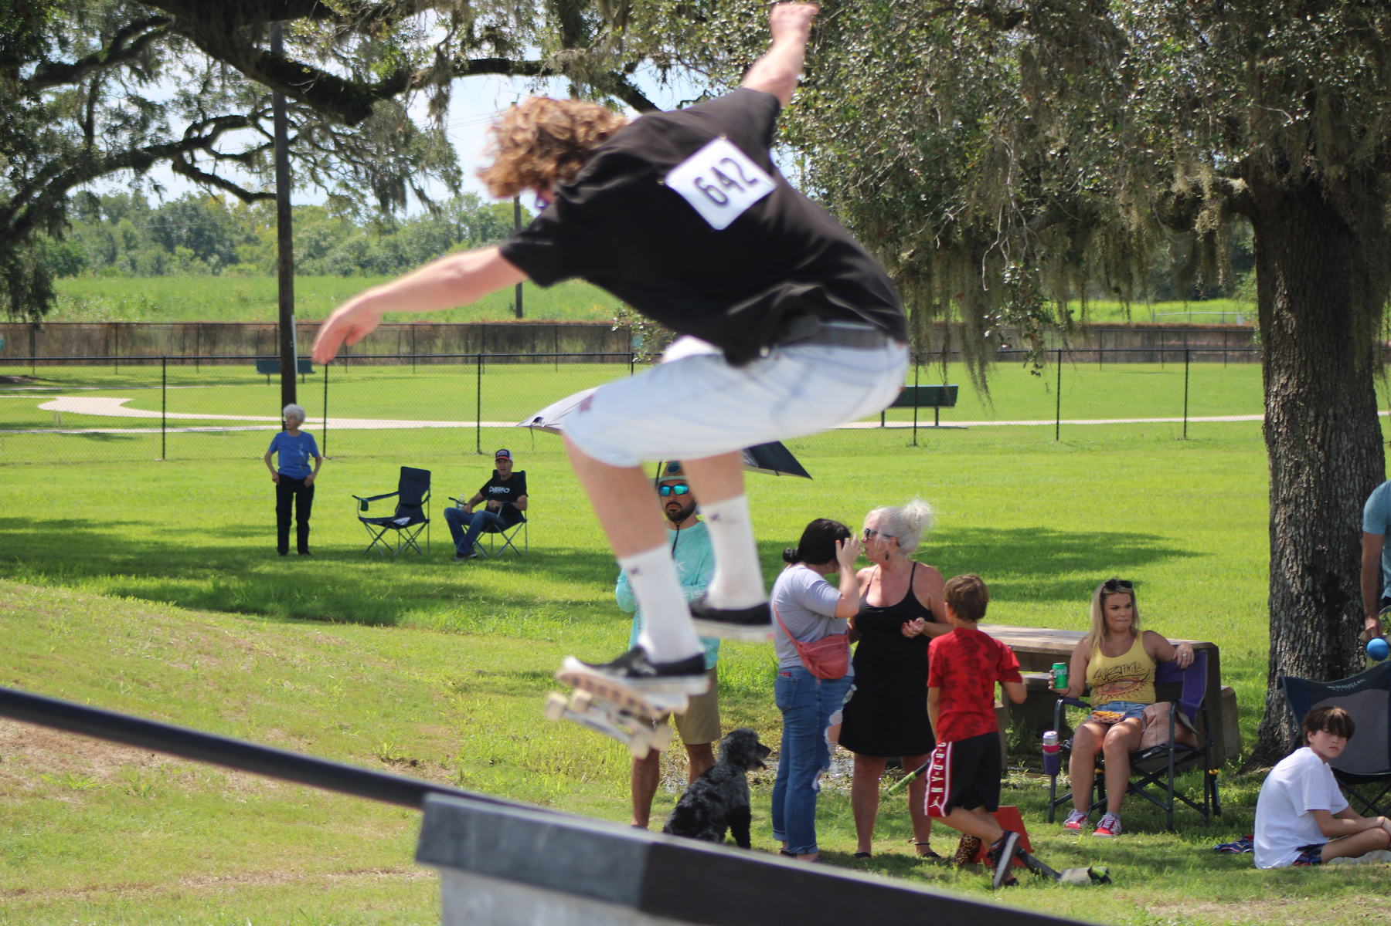
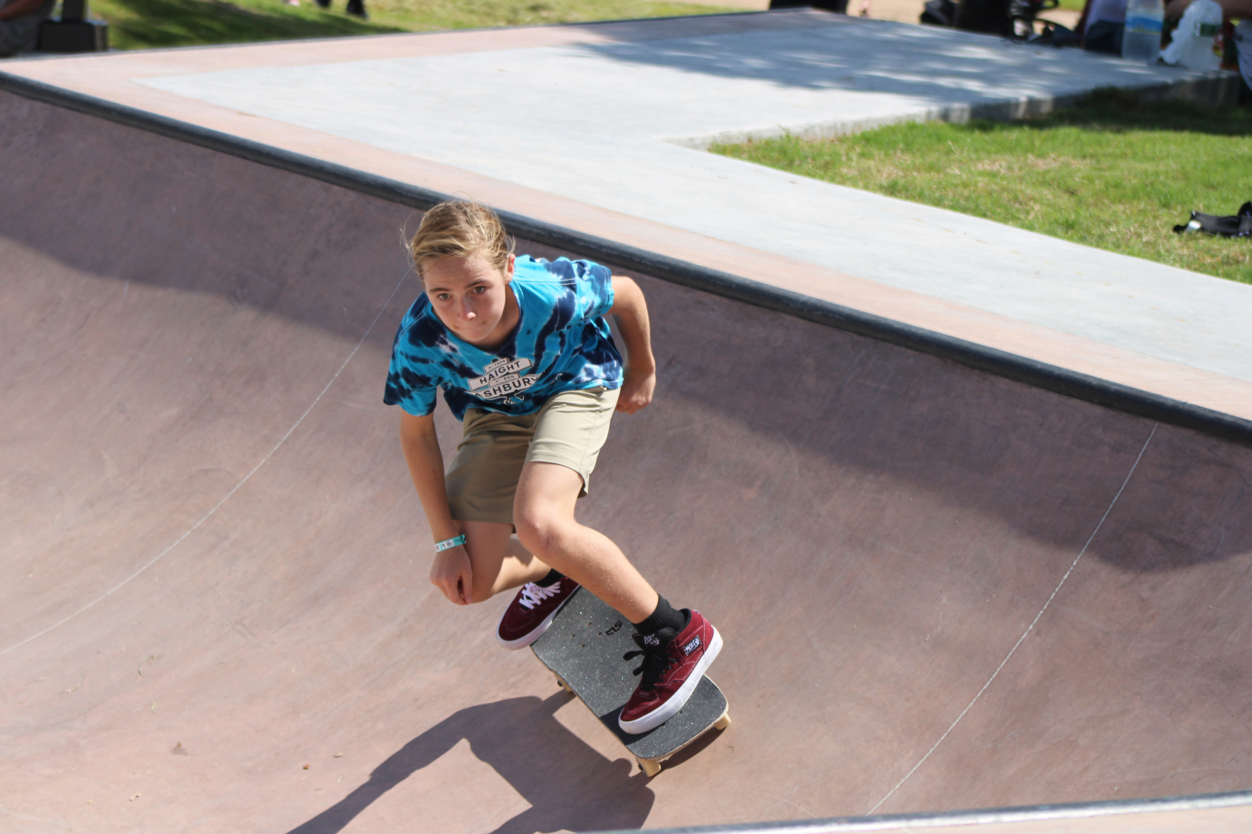
SKATE PARK GRAND OPENING

Slide 7
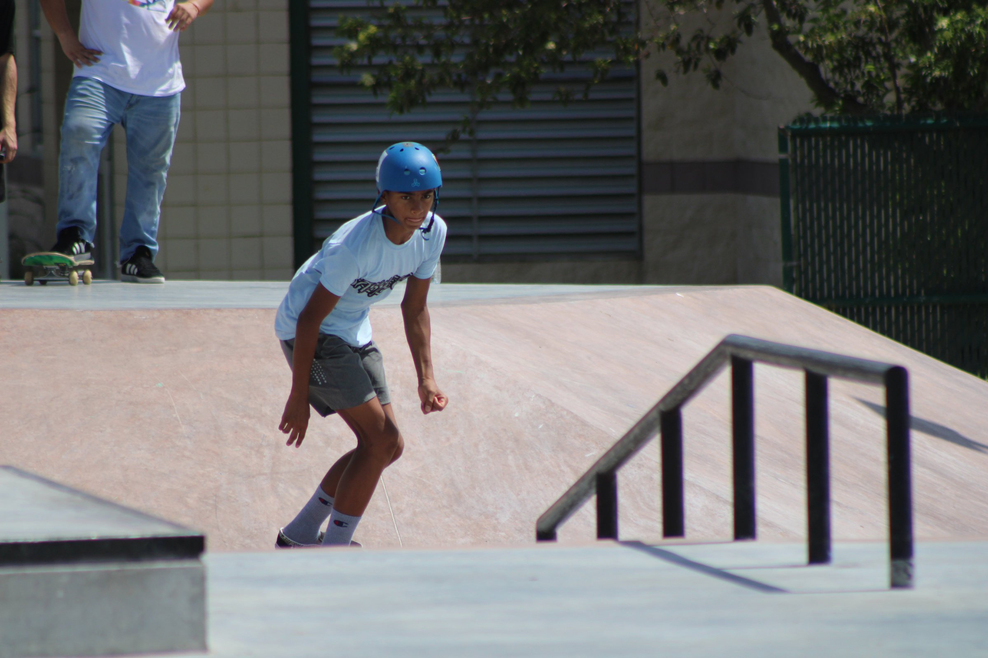
Where did the Funding come from?
This project was funded through the Capital Improvement Program (CIP) which comes from the Half-Cent Sales Tax.

