Slide 1
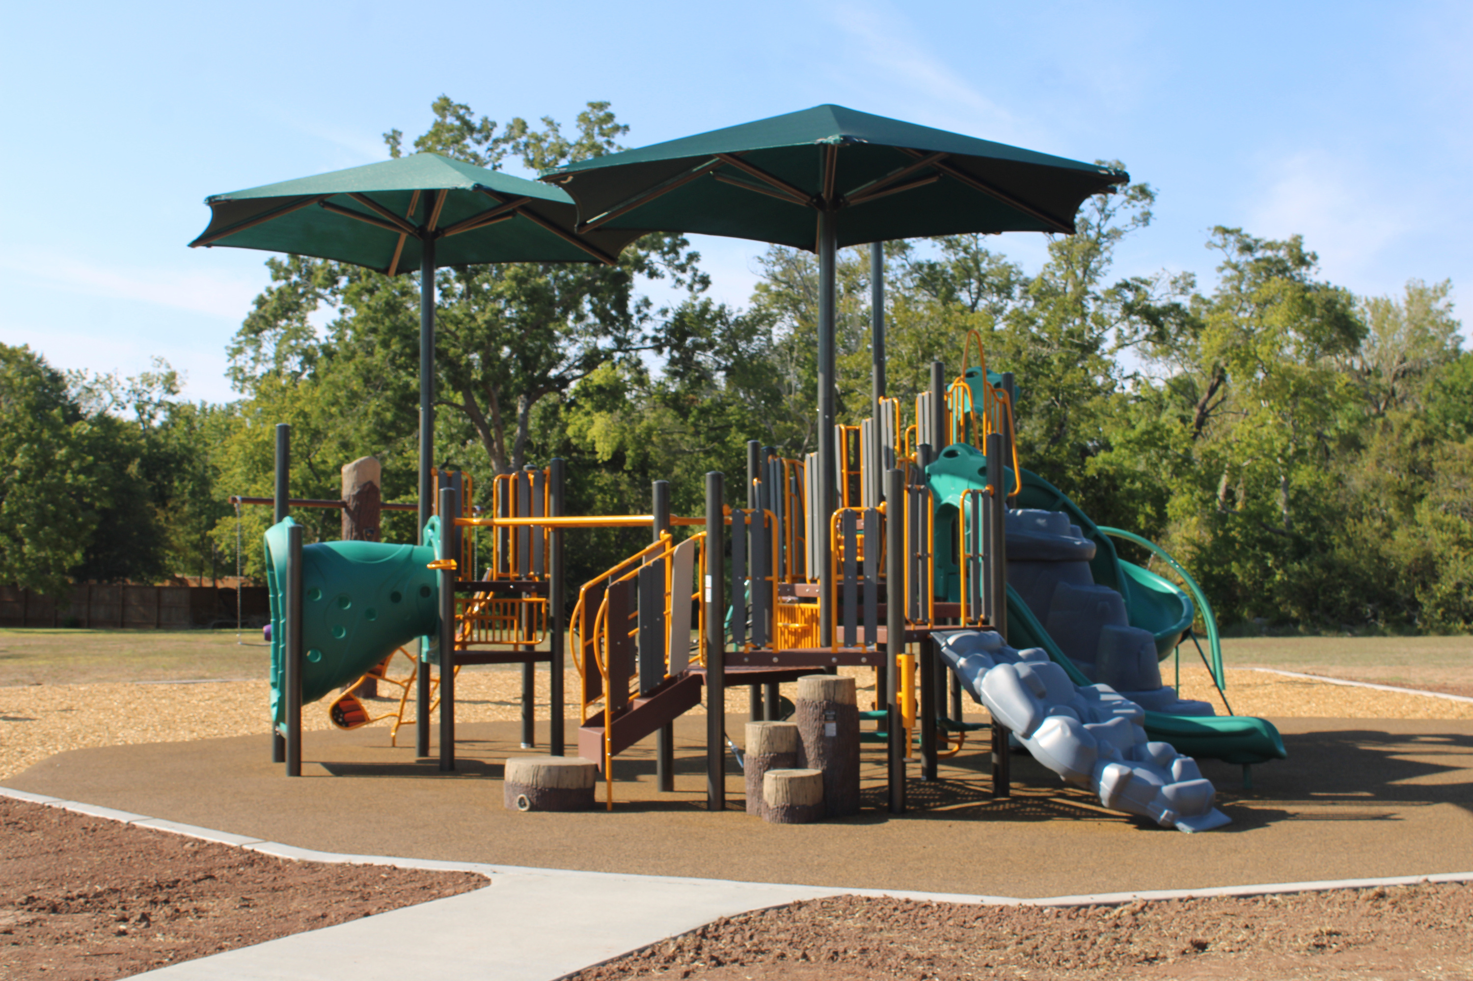

Timbercreek Playground

Slide 2
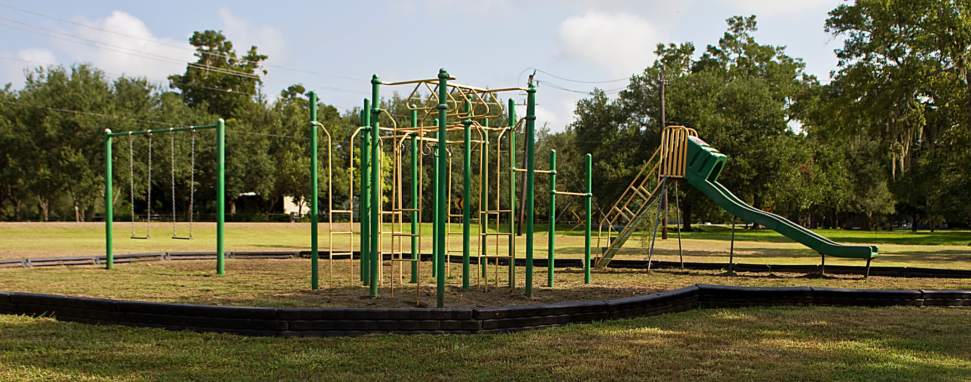
Project Background
The Timbercreek Park Complex is made up of five individual parcels. The 2016 Parks and Open Space Master Plan calls for a nature themed playground to be constructed on the southern end of the largest parcel (11.4 acres) of land that fronts Timbercreek Drive. Upon the sale of the two parcels of the Timbercreek Park Complex totaling approximately 1.45 acres that housed the previous small playground structure. It was determined that the location and size of the play structure did not meet the needs of this large neighborhood. Proceeds from this sale of property were used to develop the larger park area where the new playground sits today.

Slide 3
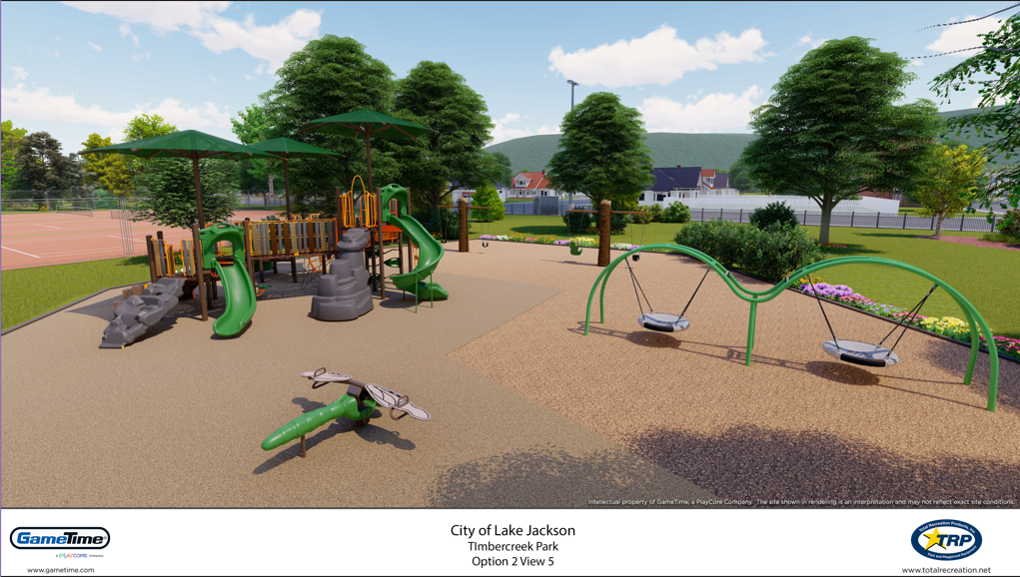
New Playground Design
The 2016 Parks and Open Space Master Plan calls for a nature themed playground to be constructed on the southern end of the largest parcel (11.4 acres) of land that fronts Timbercreek Drive. The Nature themed playground equipment was budgeted for this site through the Half-Cent Certificate of Obligation debt fund for the 2021-2022 Fiscal Year. The all new playground includes poured in place rubber surfacing pad, ramps for easy access and sidewalks leading the site. Elements of inclusive play equipment was included to address the needs of every child. The design, shown to the right, included: a Modified Cascadia 5-12 PowerScape Play Unit, Tree Swings with belt seats and zero g chairs for inclusivity, double arch swings and a dragonfly see-saw. Installation of the new playground began in May 2023 and was completed in September 2023. A Ribbon Cutting Celebration of the new playground occurred on September 12th, 2023 and featured: Mayor Roznovsky, members of City Council, Parks Advisory Board Members and representatives from GameTime (the company who installed the playground). Residents were invited to check out the new playground and were treated to sno-cones from Kona Ice courtesy of GameTime.

Slide 4
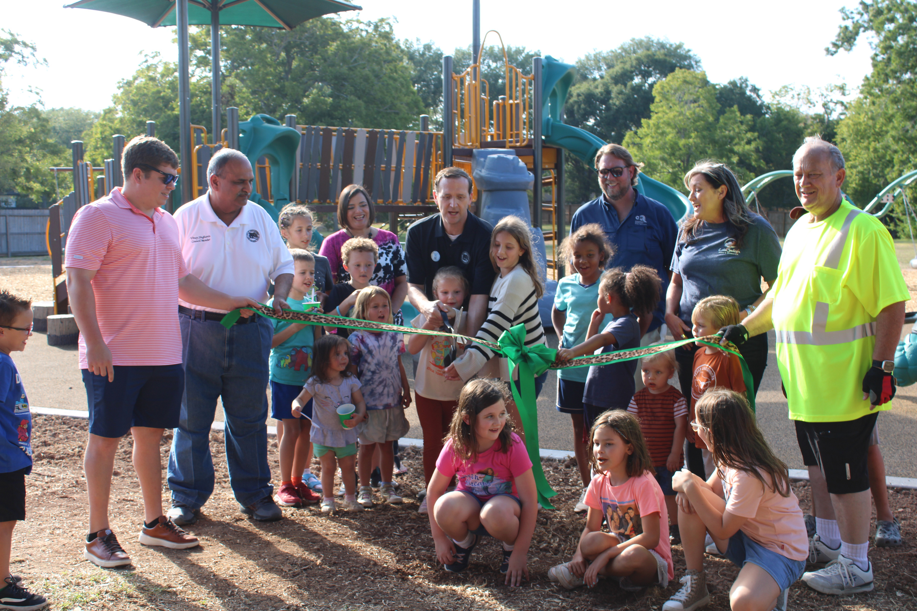
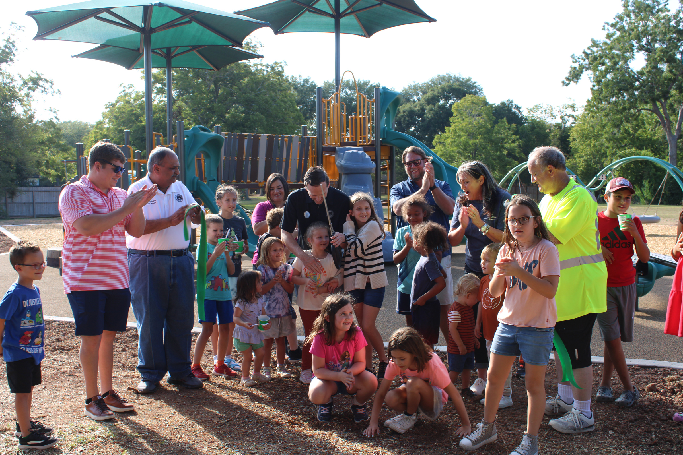
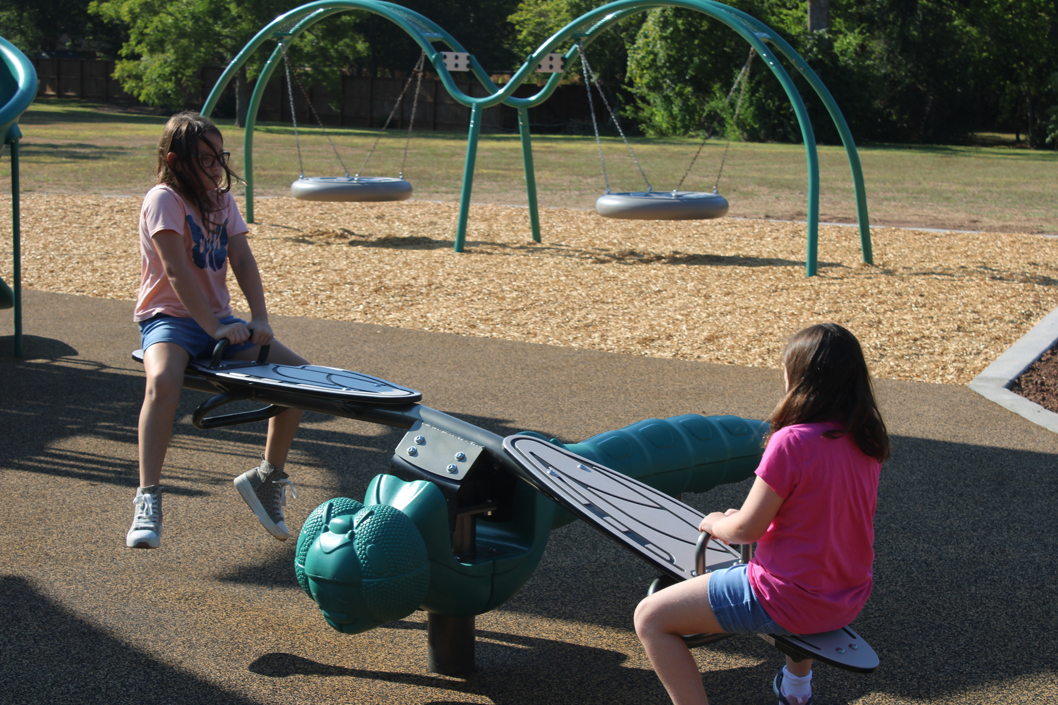
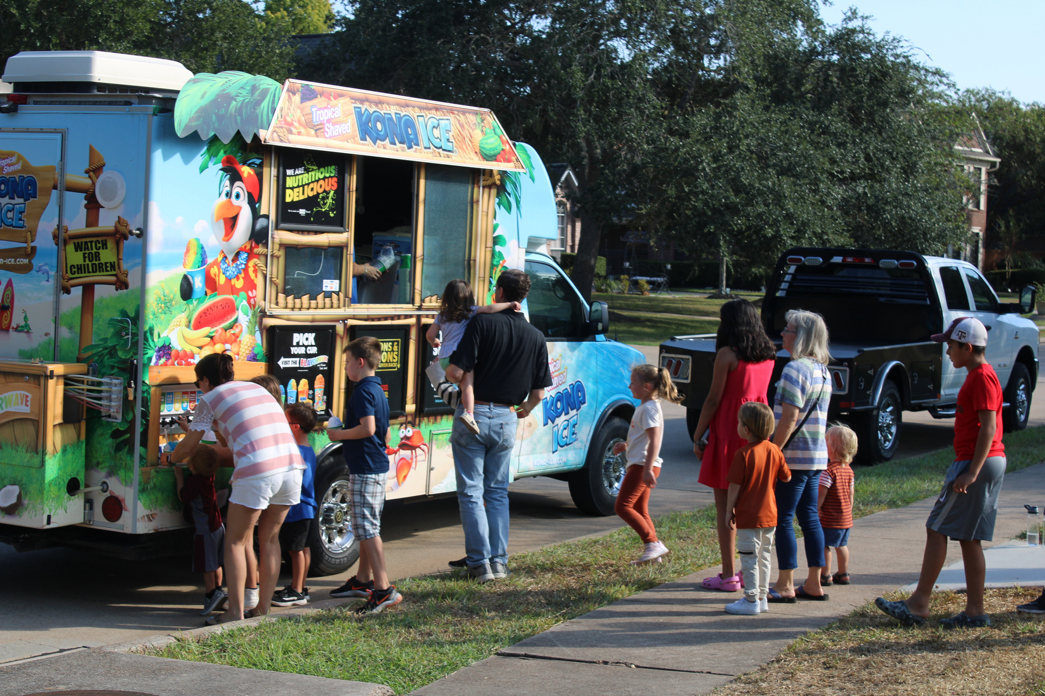
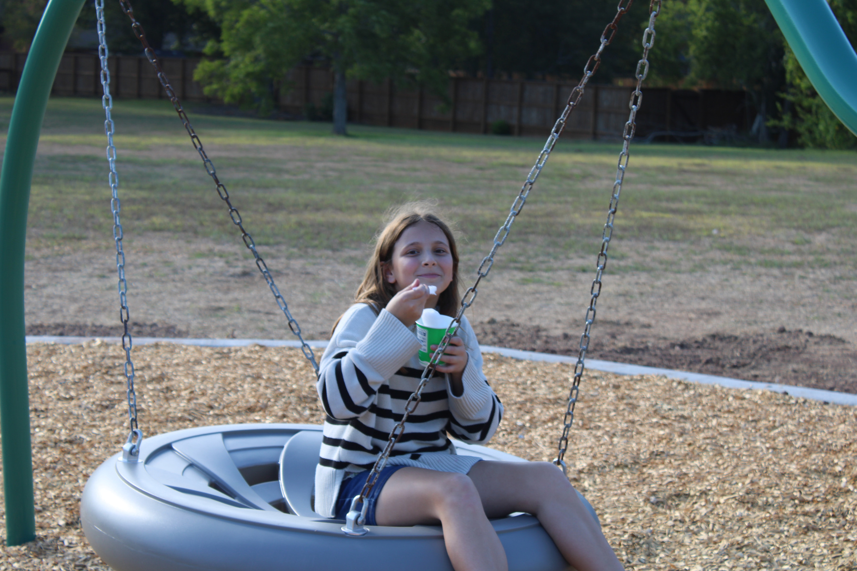
PLAYGROUND RIBBON CUTTING CEREMONY

Slide 5

Where did the Funding come from?
This project was funded through the Capital Improvement Program (CIP) which comes from the Half-Cent Sales Tax.

