Slide 1
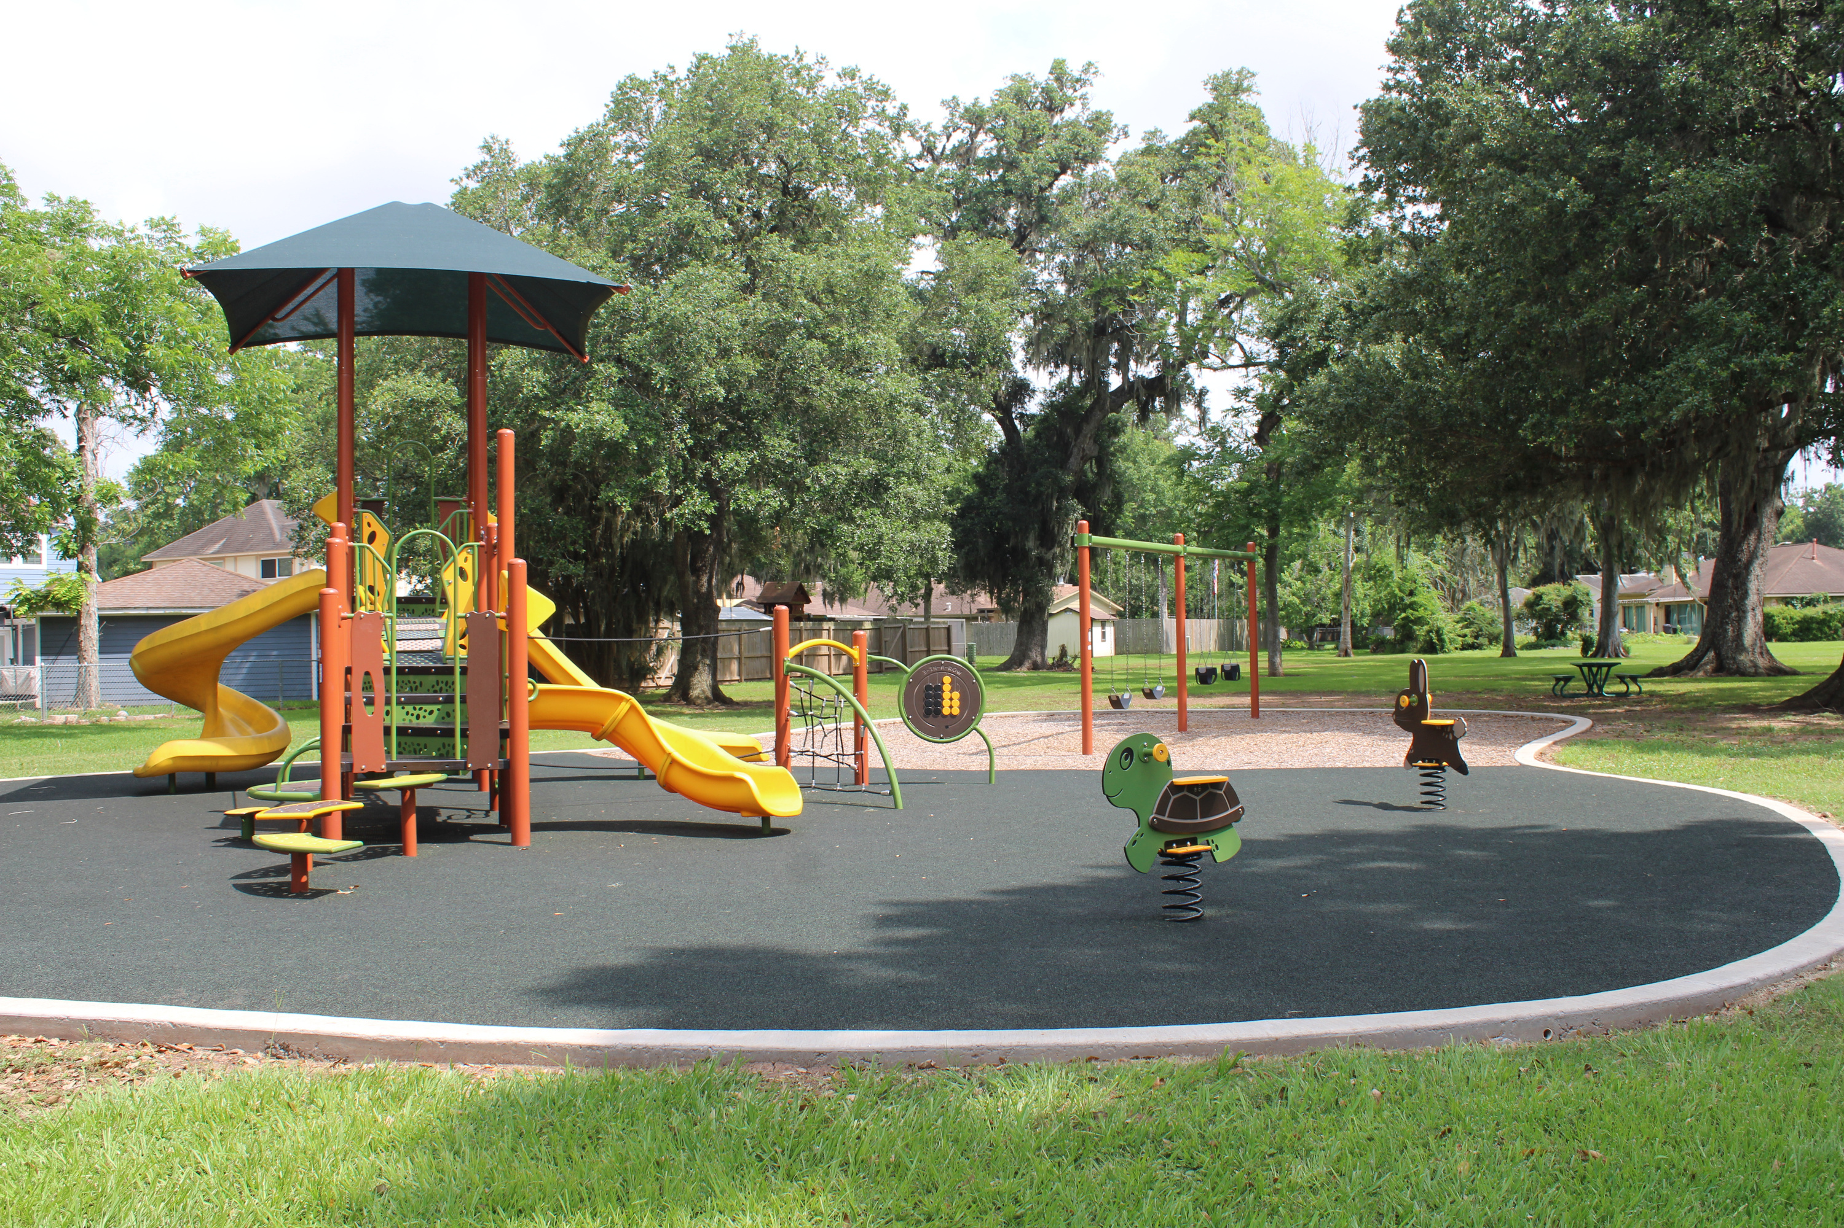

Pecan Park Playground Renovation

Slide 2
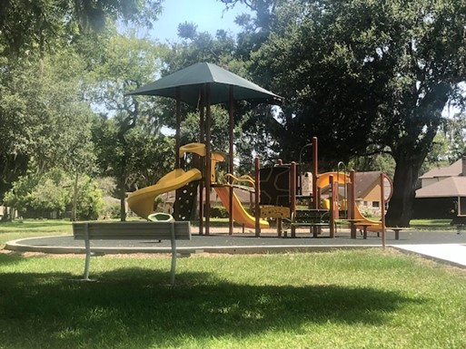
Project Background
Pecan Park is a small pocket park nestled among surrounding single family homes with access to Crocus Street. Pocket parks, or mini parks are the smallest of the park classifications and typically serve a very limited area (less than 1/4 mile or a 10 minute walk). Typically, they are 1 acre in size and include limited recreational facilities such as one playground structure, benches, and a litter receptacle. The old playground, pictured to the right, was installed in 2002 and was in need of replacement.

Slide 3
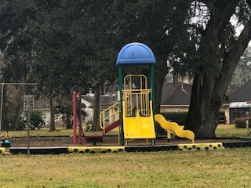
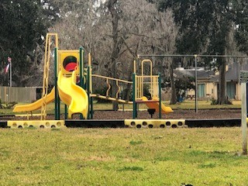
OLD PLAYGROUND

Slide 4
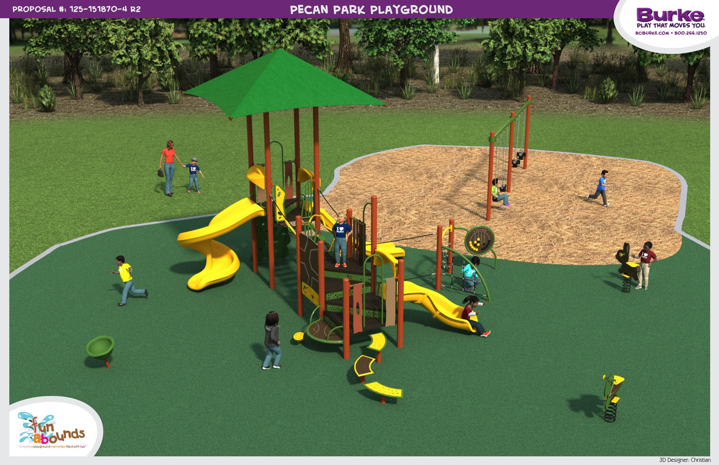
New Playground Design
As part of the 2016 Parks and Open Space Master Plan, it was determined to replace the existing playground with new equipment. Installation of the new playground began in September 2022 and was completed in November 2022. The all new playground includes poured in place rubber surfacing pad, ramps for easy access and sidewalks leading the site. The design, shown to the right, included: Animal Rockers, Play Panels, a Swing Set, Spinning features, all incorporated into the Nature Theme of the Playground itself. The playground equipment was budgeted for this site through the Half-Cent Certificate of Obligation debt fund for the 2021-2022 Fiscal Year.

Slide 5

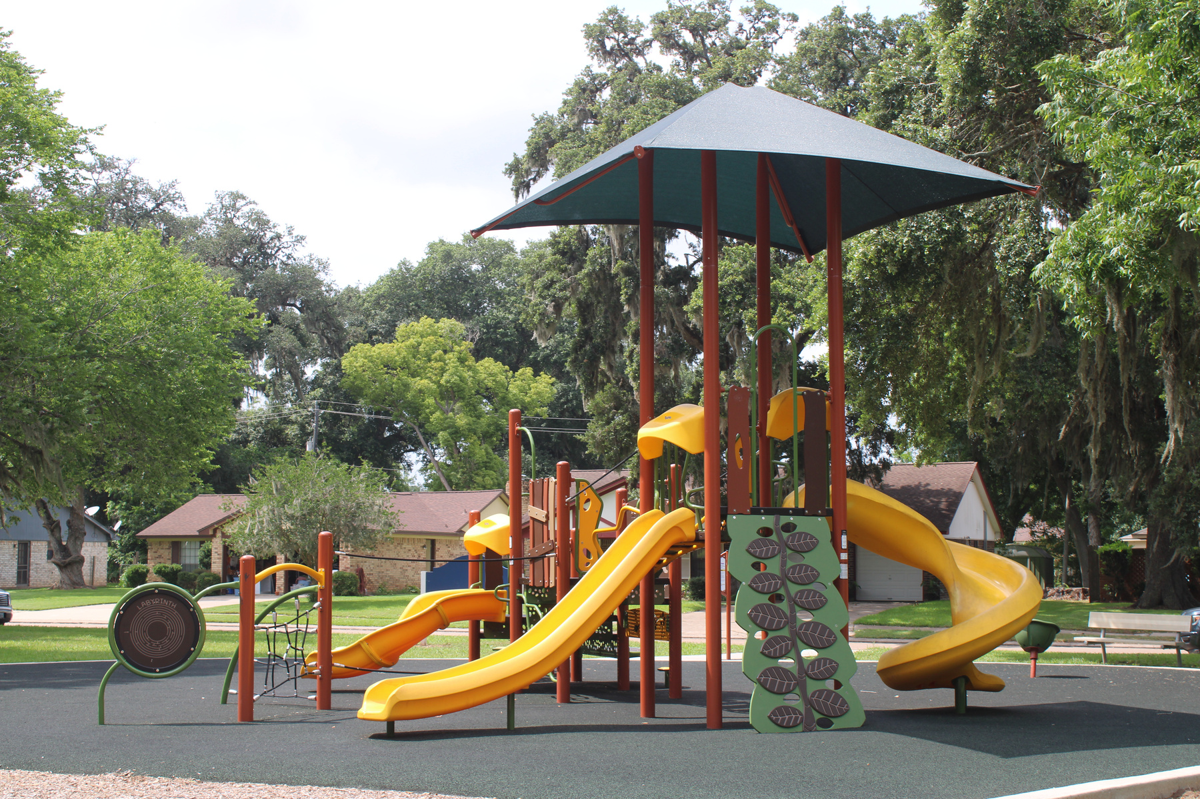
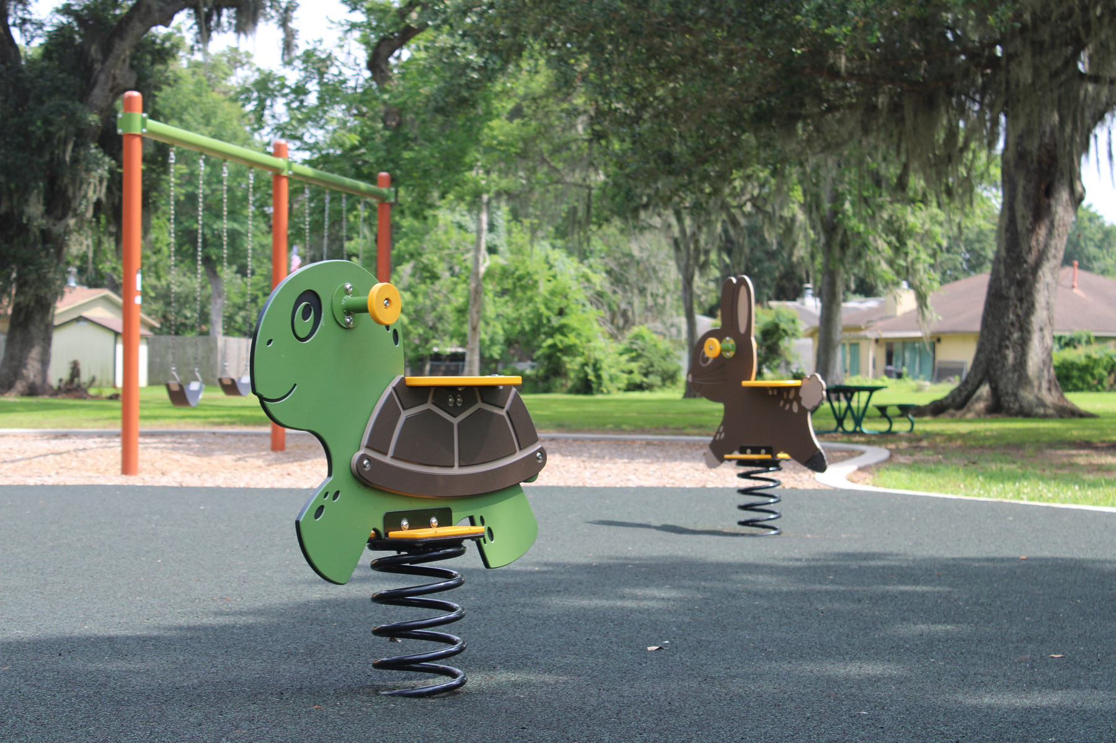
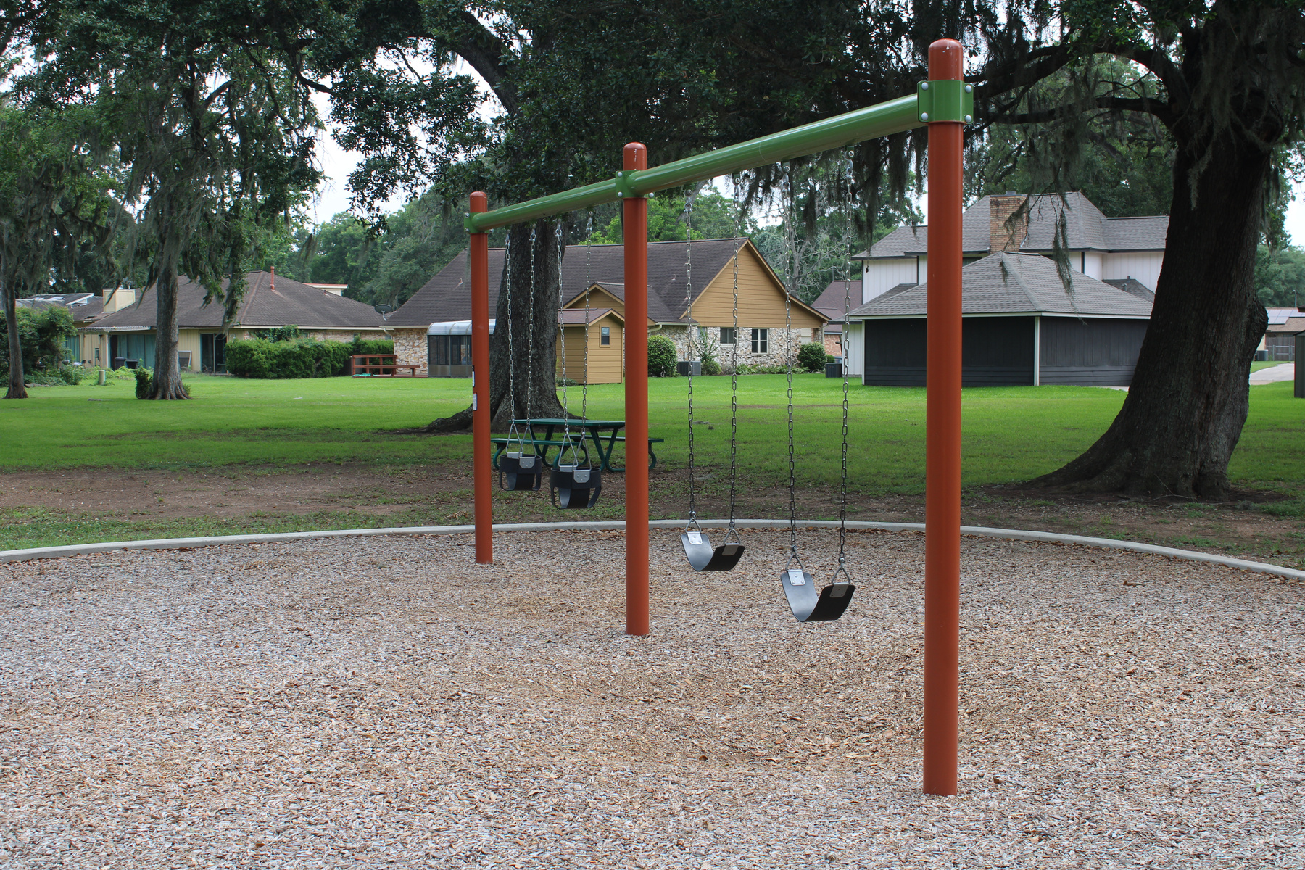
NEW PLAYGROUND EQUIPMENT

Slide 6
Where did the Funding come from?
This project was funded through the Capital Improvement Program (CIP) which comes from the Half-Cent Sales Tax.

